Slide 1
Agricultural Production and Purposes
Applying 273.13 Subd 23
Notes:
Title Slide – 90 Slides between you and world domination! – If classifying 2a properties was what were holding you back …

Slide 2
Content
1 | Title Slide
2-12 | Common Ground Rules and Data Gathering
13-58 | 10 or more acres in Production
59-74 | Intensive Confinement
75-80 | Less than 10 acres – without residence
81-89 | Less than 11 acres– with residence
89-91 | Closing
Notes:
Content

Slide 3
273.13 Subd 23 Overview
273.13 Subd 23 – Consists of 15 paragraphs. Nine of fifteen relate directly to agricultural classification (2a)
Agricultural homestead - Ag
Agricultural Land - Ag
Rural Vacant Land – Not Ag
Managed Forest Land – Not Ag
Agricultural Land defined Confinement and over 10 acres – Ag
Agricultural land defined under 10-11 acres – Ag
Agricultural land use by another For Ag Purposes – Ag
This section Supersedes Local definitions of Min-Max acres – Ag
Agricultural Products defined – Ag
Agricultural/Commercial industrial Split Class – Ag
HGA listing requirements – Ag
Airport Landing Area – Not Ag
Commercial Aggregate not mined – Not Ag
Commercial Aggregate Not mined conversion to mined – Not Ag
Definitions in (c) and (d) are not rules – Not Ag
Notes:
Statutory Reference – The basis of your decision. Subdivision 23 directs the classification for Property Class 2. That includes 2a Agricultural, 2b Rural Vacant Land, 2c managed forest land, 2d Airport landing area and 2e Commercial aggregate not mined in a county that did not opt out ….. 15 paragraphs, 9 of fifteen relate to 2a

Slide 4
Class 2a –Agricultural Land – Ground Rules
Class 2a agricultural land consists of parcels of property, or portions thereof that are agricultural land and buildings.
Class 2a land may be homestead or non-homestead depending on ownership, occupancy and active farming scenarios. The homestead determination is made independently of the classification of the property.
The agricultural products are defined by statute.
Classification based on the preceding year’s use of the land.
The agricultural product must be produced for sale.
Classification under this section supersedes, for property tax purposes only, any locally administered agricultural policies or land use restrictions that define minimum or maximum farm acreage.
The land must be classified as class 2a if all or a portion of the agricultural use of that property is the leasing to, or use by, another person for agricultural purposes. (note – exceptions)
The land is being classified NOT the owner.
Notes:
Some – (Eight) Ground Rule
Note - exceptions – maple syrup, Apiary, some Storage and drying ..

Slide 5
Class 2a -House, Garage and One Acre (HGA)
When assessing farm property, the assessor must determine and list separately on the property
records the market value of the HGA. If any farm buildings or structures are located on this
acre of land, their market value shall not be included in this separate determination. This
allocation is very important and it is used for state aids, referendum market values, property
tax refunds, etc.. Assessors should take great care in making certain these values are uniform
and equalized.
Dwelling(s) on 2a property – Split One acre and tie to the dwelling.
Class 2a HGA if homesteaded by the owner or a qualifying Relative
Class 1a Residential if homestead by qualifying relative
Class 4bb (2) non homestead dwelling if only dwelling on parcel
Class 4b (3) non homestead dwelling on parcel containing two or three units
Class 4c (12) Seasonal
Notes:
Dwelling classification – HGA Discussion, any farm buildings located on the one acre shall not be included in the hga.
Some Class options

Slide 6
Split Class – Value and Acres
If a parcel is used for both agricultural purpose and for commercial or industrial purposes
including but not limited to:
1. Wholesale and retail sales;
2. Processing of raw agricultural products or other goods;
3. Warehousing or storage of processed goods; and
4. Office facilities for the support of the activities listed above.
For such activities, the assessor shall classify the portion of the property used for productive
agricultural purposes as class 2a and the remainder in the class appropriate to its use.
The grading, sorting, and packaging of raw agricultural products for first sale is considered to be an agricultural purpose
Parcel EMV/acres
2a Land and Buildings
Commercial / Industrial
2b
2c
2a HGA
exempt
Any other class – 1a, 4b, 4bb, etc.
Notes:
Split class variations, Some parcels may be all 2a or include one or more additional classes. Discussion on grading sorting packaging – Apples for example - grade sort package is ag-set up a retail portion, produce and package apple sauce. The portion of the property used for processing apple sauce and or selling split out as commercial.

Slide 7
County Policy
Assessors may be required to make some subjective decisions to determine if statutory
requirements are met before classifying a property as class 2a agricultural land, but the
decision should be based on a list of objective factors that are always considered before the
decision is finalized.
Ag use Survey
Timing - Deadlines
Required Documentation
Verification procedures
Beyond the owners control- weather, renters
Production Benchmarks
And ??
Notes:
Some things to think about regarding county policy.
Ag Use Survey – to collect data, Every acre and use accounted for ..
Timing/Deadlines – timing for returning ag use survey, reporting production
Required Documentation – proof of sale, proof of rent, proof of CRP/Rim,
Verification procedures – Field Visits, aerial review, How to follow up if questionable.
Beyond owners control – uniform standards
Production benchmarks – Related to production cycle, or number of animals produced.
And ….

Slide 8
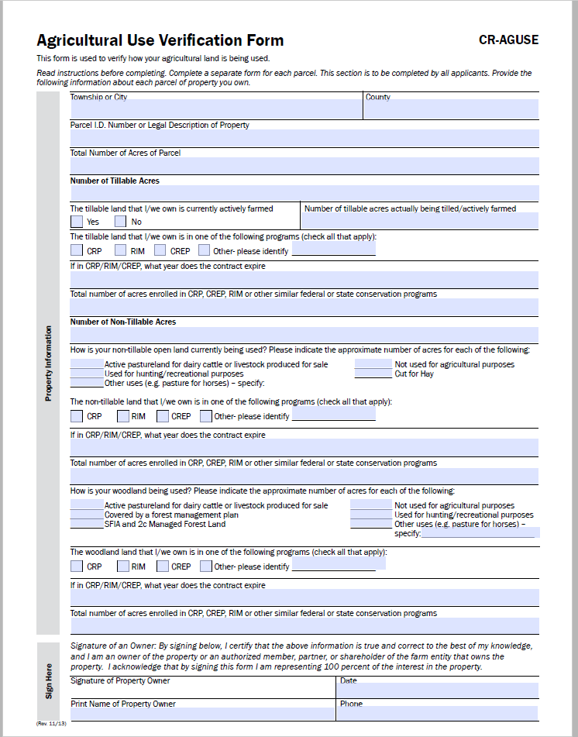
Ag Use Survey
State verification form available in Virtual Room
Parcel Maps, County GIS
Conservation Program Enrollment.
Production / product sale information.
Rental / lease information.
Consideration to have property classified as Agricultural for Property Tax Purposes. The classification is for the _______________ Assessment Year, Taxes Payable ___________.
Notes:
Use Survey, application, maps, aerials. Discussion on time lag between Use/Class and tax benefit.

Slide 9
Use Surveys lead to Discovery ..
Ownership
Preceding Year Classification
Preceding Years use
Contiguous definitions and size determinations
A Limited Number of Ag purposes specify “by the owner”
To know who to get information from
Property qualifying as 2a due to enrollment in a conservation program must have been 2a in the year preceding enrollment.
2a classification is based on preceding years use.
Produced For Sale
What was the product?
Was the product sold?
Where did the production occur?
When?
Account for every Acre.
Notes:
Be able to Identify-

Slide 10
2a use, determination, and appeal Timeline
Preceding year prior to January 1
Qualifying 2a Use takes Place
January 2nd
2a Classification Determination
Prior to June 30th
Local & County Appeals
2a Classification Set
Notes:
Abbreviated timeline – After appeals 2a and 2b classes are “set”, a change requires abatement. Tax Court is a possibility.. New information regarding past use can be considered for next assessment year.
Use changes after assessment date do not change the class during the appeals process – wait for next year…

Slide 11
The Goal
273.13 Subd.23
County Policy
Ag Use Survey
Consistent Justifiable 2a Determinations
Notes:
We Have A Goal ! It Improves the assessment..

Slide 12
Agricultural Production and Purposes
Applying 273.13 Subd 23
Notes:
Meat and Potatoes

Slide 13
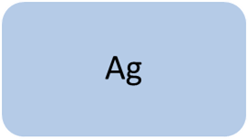
2a – Four Statutory Categories
10 or more contiguous Acres Agricultural Purposes -273.13 subd.23 (e) (1) .
10 -10.99 Acres No Dwelling and 11 plus acres with or without dwelling.
Less than Ten acres Exclusively used for Agricultural Purposes – 273.13 subd.23 (f) (1)
Less than 11 acres including a dwelling 273.13 subd.23 (f) (2)
Less than 10 acres No Dwelling.
Intensive Livestock or Poultry Confinement Operation – 273.13 subd.23 (e) (2)
Property of any Acreage, with or without dwelling.
Less than 11 acres with a dwelling.
Notes:
The Four categories, only four there are no more. Statutory Reference and Acreage Dwelling Requirements

Slide 14
Ag
10 or more contiguous Acres Agricultural Purposes
Intensive livestock or poultry confinement
Less than Ten acres Exclusively used for Agricultural Purposes
Less than 11 acres with a dwelling
Notes:
Representation of preponderance statewide – Size of circle relatively relates the likelihood of qualification under each of the four categories

Slide 15
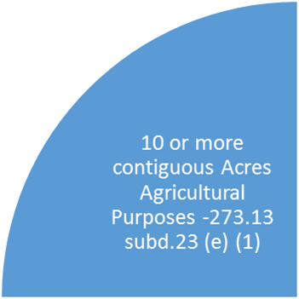
Most Common
  10 -10.99 Acres No Dwelling and 11 plus acres with or without dwelling.

Slide 16
Contiguous, what’s that mean? - Two Variations
Statute language - "Contiguous acreage," for purposes of this paragraph, means all of, or a contiguous portion of, a tax parcel as described in section 272.193, or all of, or a contiguous portion of, a set of contiguous tax parcels under that section that are owned by the same person.
Contiguous Parcels under the same ownership- Has implications for homestead on 2b Rural Vacant Land.
Contiguous Portions - relating to property use within a parcel or a group of parcels with common ownership. Determining factor in meeting 10 acre minimum ag use.
Notes:
Differentiating contiguous standards and meanings applied to 273.13 Subd.23 (e) (1)

Slide 17
10 Contiguous Acres Being Used For Agricultural Purposes Contiguous relating to property use within a parcel or a group of parcels with common ownership.
“Contiguous” is defined by the dictionary provided by law.com as “connected or next to, usually meaning adjoining pieces of real estate.” This means a property should not typically be classified as agricultural when there is a total of 10 productive acres if those acres are broken up in small plots.
Lands that will be deemed “impractical to separate” (i.e. ditches, waterways, fence lines, etc..) also do not break up the contiguity of the agricultural land.
Parcel lines or separate legal descriptions do not break up the contiguity of land masses used for agricultural purposes as long as the parcels are in the same ownership.
Notes:
Contiguous ag use within common ownership

Slide 18
In some rare circumstances …. Contiguous relating to property use within a parcel or a group of parcels with common ownership.
In some rare circumstances reasonable justification may warrant classifying smaller land masses as class 2a agricultural land if the agricultural land on the parcel(s) totals at least 10 acres.
To justify the classification in these cases, the assessor must use common sense and professional
judgment in considering the following list of criteria:
Overall size (number of acres)
Number of acres used agriculturally in relation to overall acres
Crop being raised and sold on the agricultural acres
Composition of agriculturally used acres (contiguous or noncontiguous)
Notes:
Statement on variations and exceptions to previous slide, This references odd instances like say 20 acre parcel with two 9 acre fields or a parcel with a 4 acre field separated from a 20 acre field …

Slide 19
Agricultural Purposes – 21 defined uses within 273.13 Subd.23 (e) (1)
17 – Apparent Uses
Production For the Sale of:
4 – Obscure Uses
Participation of Qualified Acreage in Qualified Conservation Programs
Notes:
Breaking 21 defined Ag production options into two categories, reflecting ease of identifying. Next group of slides will discuss “apparent” use first, then pivot to “obscure” uses.

Slide 20
Apparent Production Uses – Common Characteristics
Defined Boundaries
Fences
Field Boundaries
Special use buildings
Physical Manipulation
Cleared of trees
Cultivated
Harvested
Annual Fiscal Impacts
Expenses
Income
Risk
Notes:
Factors that make apparent use apparent. Defined boundaries and physical manipulation make identification thru field inspections easier. The annual fiscal impacts produce documented evidence of production and sale.

Slide 21
Production equals 2a classification when …..
Your Growing what?
Typical products/production | Atypical products/production | Experimental products/production
Common products that have a proven production history in your County. | Uncommon products that have a proven production history in your County. | Products without a successful production history in your County.
Majority of acreage in your county is classified as 2a due to similar production. | Some acreage in your county is classified 2a due to similar production. | No acreage in your county is classified 2a due to similar production. (Note: Look to Surrounding/other Counties)
Meet the 2a definition upon initiation if similar process / commitment as others with Proven Production History | Meet the 2a definition upon initiation if similar process / commitment as others with Proven Production History | Meet the agricultural definition when product is sold in the preceding year
Considerations: Is the investment for items that prepare for production? Versus items that initiate production leading to harvest. Example: Clearing land to plant Christmas trees is preparing for production; the cleared land is not production. Buying Christmas tree seedlings and planting them is an investment that initiates production leading to harvest
Notes:
Discussion on what is typical in your county - Look at the product produced AND the production practice. For example Christmas trees are typically grown from nursery stock as transplanted seedlings. This may be an atypical product in your county. If a grower decides to grow trees from seed rather then transplanted seedlings, that may be an experimental practice. When is that 2a production?

Slide 22
Apparent Production Uses – Getting to 10 acres -17 avenues and countless combined paths.
Acreage Makers – 3 avenues
Tweeners – 6 avenues
Exception Takers – 8 avenues
Majority of Agricultural Acres, typically greater than 10 Acres.
Less Common, typically less than 10 acres with localized exceptions.
Rarely reach 10 acres, often an exception to clarify the inclusion of non-typical Agricultural uses as Agricultural. Seldom qualify as a sole Ag use.
Notes:
Categorizing the 17 apparent uses. Describing relative occurrence and illustrating difference between common practice ag uses and less common uses which are defined in statute for inclusion as ag. The “exception takers” and to a lesser degree the “Tweeners” are uses that are identified and statutorily defined primarily to allow there use to be included as agricultural production on properties that are crossing the 10 acre agricultural threshold through one of the more common uses, (the acreage makers)

Slide 23
Production for the sale of:
Acreage Makers
Livestock, Dairy animals/products – Pasture/Barnyard
Forage – Hay, Silage
Grain – Small Grain, Row Crops, Corn, beans etc..
Notes:
This slide identifies the 3 “acreage makers”. The next three slides describe each of the 3 acreage makers in more detail

Slide 24
Livestock, Dairy animals/products – Pasture/ Barnyard
Pasture | Rotational Grazing | Fenced | Feedlot
Barnyard | Free Range | Shelter
Livestock types
Cattle | Swine | Goats | Sheep
Horses (and other equines) - bred for sale | Farmed Cervidae -Deer, Elk, Moose Farmed Llamas Farmed Ratitae – Ostrich, Emus, Rheas Raised for the purpose of producing fiber, meat, or animal by-products or as breeding stock.
Livestock, Dairy animals/products – Pasture/ Barnyard
Notes:
Terms related to land use and a listing of livestock types

Slide 25
Grain – Small Grain, Row Crops
Corn | Soybeans | Edible Beans | Sunflowers
Oats | Rye | Wheat | Barley
Wild Rice | Canola | Prevented Plant, Disaster – with a crop history | Fallow/cover crop – with a crop history
Granary | Bin | Straw | And so on
Grain – Small Grain, Row Crops,
Prevented Plant, Disaster – There are terms that describe land which is typically farmed and is not in production due to reasons beyond the owners control. Fallow is short term idling of land as a management practice. These are examples of uses that require a crop history and should have a standardized benchmark applied to determine when the property is no longer considered in agricultural use.
Notes:
Listing of types of grain and terms related to grain. Discussion on Fallow and prevented plant

Slide 26
Forage – Hay, Silage
Alfalfa | Clover | Wild Hay | Sorghum
Sudan Grass | Millet | Timothy | Orchard grass
Brome grass | Reed Canary grass | Ryegrass | Bluegrass
Native Grass | Switch grass | Field peas | Fescue
Bluestem | Grama grass | Meadow hay | And so on …
Forage – Hay, Silage
Wild hay and Meadow Hay are uses that can fluctuate with the weather. A standardized benchmark should be applied to determine when the property is no longer considered in agricultural use.
Notes:
Discussion on forage hay and silage. Specifics related to wild/meadow hay. Weather can prevent harvest counties need to identify bench mark … 3 of 5 years for example ..

Slide 27
Production for the sale of:
Tweener
Horticultural and Nursery Stock
Fruit of all Kinds
Vegetables
Maple Syrup/trees - conditional
Poultry and Poultry Products, Birds, eggs
Trees, grown for sale as a crop, including short rotation woody crops, and not sold for timber, lumber, wood, or wood products
Notes:
The next 7 slides will cover “tweener” Less Common than acreage makers,
Smaller footprint on the land, typically less than 10 acres with localized exceptions. Some parts of the state have large orchards, vegetables are also grown on large acreage in areas closer to processing plants.
Items identified as “Conditional” have specific requirements not listed on this slide.

Slide 28
Poultry and Poultry Products
Eggs | Breeding Stock | Meat | Domesticated
Geese | Chickens | Guinea fowl | Ducks
And …
Poultry and Poultry Products, Birds, eggs
Notes:
Domesticated Fowl – Birds of a feather

Slide 29
Fruit of all Kinds, Vegetables
Fruit of all Kinds
Fruit trees | Nut trees | Berries | Potato
Sugar Beets | Pumpkin | Table Vegetables | Field, Garden, Green House, High Tunnel
Grapes | And ..
Vegetables
Notes:
I planted Plum trees on 10 acres, five years from now I am planning to sell, when do I get the 2a class? How about Pineapple trees? What is typical for your county? County policy?

Slide 30
Trees, grown for sale as a crop, including short rotation woody crops, and not sold for timber, lumber, wood, or wood products
Christmas Tree Plantation | Short rotation Woody Crops | And …
Trees, grown for sale as a crop, including short rotation woody crops, and not sold for timber, lumber, wood, or wood products
Notes:
Trees sold without root, I planted Christmas trees on 10 acres, five years from now I am planning to sell, when do I get the 2a class? What is typical for your county? County policy?

Slide 31
Short Rotation Woody Crops
Short rotation woody crops are woody tree species that have been bred and selected to have extremely high rates of growth, allowing them to be harvested after a short growing period. They are an ideal feedstock component for biomass supply chains. While many hardwood species have full management rotations that may approach 50 years or more in length, short rotation woody crops can be harvested every three to seven years. While short in rotation, these trees make up for it with high yields. Short rotation trees can be utilized for the production of liquid fuels, such as ethanol, diesel, and jet fuels. They can also be used for the production of heat, steam, and/or electricity. Due to their rapid growth, their wood is valued for fiber and not strong lumber or other products.
Hybrid poplar (Populus spp.) and willow (Salix spp.) are the two species most commonly adapted to short rotation management. Poplars are typically grown in the mid-Atlantic, Southeast, and Northwestern portions of the US. Willow is a more cold-tolerant species and is the species of choice in the upper Midwest and Northeastern parts of the country. Both types of hardwoods are coppice species. Coppicing occurs when the tree is harvested and a new sprouts grow from the existing root system. Having trees that exhibit this trait allows for multiple harvests following a single planting.
Trees, grown for sale as a crop, including short rotation woody crops, and not sold for timber, lumber, wood, or wood products
Notes:
One Definition

Slide 32
Horticultural and Nursery Stock
Trees | Shrubs | Fruit and Nut Plants | Annual Bedding Plants
Potted flowering plants | Potted Herbaceous Perennials | Sod Sprigs and Plugs | Food Crops under Protection
and …
Horticultural and Nursery Stock
A greenhouse or other building where horticultural or nursery products are grown that is also
used for the purpose of retail sales must be classified as agricultural only if it is primarily used
for growing horticultural or nursery stock from seeds, cuttings or roots, and occasionally as a
showroom for the retail sale of the products. The use of a greenhouse or building only for the
display of already grown horticultural or nursery products does not qualify as an agricultural
purpose. - Commercial
Notes:
Differentiates when a green house or other building can have retail sales portion of the building be ag (only if that portion is used primarily for growing and occasionally for sales)
Also - The use of a greenhouse or building only for the display of already grown horticultural or nursery products does not qualify as an agricultural purpose.
I planted Sugar Maple trees on 10 acres, five years from now I am planning to sell, when do I get the 2a class? How about Coffee trees?

Slide 33
Nursery Stock is subject to 18H Nursery Law
18H.02 DEFINITIONS.
Subd. 20.Nursery stock. "Nursery stock" means a plant intended for planting or propagation, including, but not limited to, trees, shrubs, vines, perennials, biennials, grafts, cuttings, and buds that may be sold for propagation, whether cultivated or wild, and all viable parts of these plants. Nursery stock does not include:
(1) field and forage crops or sod;
(2) seeds;
(3) vegetable plants, bulbs, or tubers;
(4) cut flowers, unless stems or other portions are intended for propagation;
(5) annuals; or
(6) Christmas trees.
Horticultural and Nursery Stock
Notes:
Definition of nursery Stock from State Nursery Law, Subject to Certification requirements by Minnesota Department of Agriculture if more than “occasional” production.
All Items listed under “Nursery stock does not include” may be considered Horticultural Stock. In part the purpose of the slide is to show what “nursery stock” is, and therefore requires a certificate, which the assessor may ask for to help with verification.

Slide 34
Horticultural Stock – Not defined by statute…
Horticultural Crops As defined by -
But to use this definition of a horticultural product, it is necessary to know what crops are appropriately assigned to horticultural industry. It is generally accepted by researchers and educators in horticultural science that horticultural crops include:
•tree, bush and perennial vine fruits;
•perennial bush and tree nuts;
•vegetables (roots, tubers, shoots, stems, leaves, fruits and flowers of edible and mainly annual plants);
•aromatic and medicinal foliage, seeds and roots (from annual or perennial plants);
•cut flowers, potted ornamental plants, and bedding plants (involving both annual or perennial plants); and
•trees, shrubs, turf and ornamental grasses propagated and produced in nurseries for use in landscaping or for establishing fruit orchards or other crop production units.
Sometimes the horticultural plant is used by an animal to produce the crop. Honey is a good example and is often considered to be a horticultural product. Raw silk is produced by silkworms feeding on mulberry trees (which also produce an edible fruit) but silk is not a horticultural crop. In Canada both honey and maple syrup are classed as horticultural crops. Cultivated or gathered mushrooms (edible fungi) are most often classed as horticultural crops.
Horticultural and Nursery Stock
Notes:
Not defined by statute but elsewhere … Bottom paragraph gibberish except -includes mushrooms

Slide 35
Maple Syrup/trees - conditional
maple syrup taken from trees grown by a person who is licensed by the Minnesota Department of Agriculture under Minnesota Statutes, Chapter 28A as a food processor. Acreage = Area with tapped maple trees. Note - processing & packaging split out as commercial “By the owner”
Maple Syrup/trees - conditional
Notes:
Maple Syruple is conditional - the owner is required to be licensed as a food processer under Chapter 28 A. This licensing is administered by the Minnesota Department of Agriculture. The license is not required for any other purpose then receiving the Ag Class. No other Minnesota Department of Agriculture license can be used as an alternative.
Processing and packaging are commercial

Slide 36

Production for the sale of:
Exception Takers
Bees and Apiary Products by the Owner
Fur Bearing Animals
insects that are primarily bred to be used as food for animals
Game birds and waterfowl for game farms - Conditional
Nonprofit equestrian organization - Conditional
Commercial Boarding of Horses - Conditional
Aquaculture - Conditional
Drying, or storage of agricultural products , machinery or equipment - Conditional
The “exception takers” are uses that are identified and statutorily defined primarily to allow there use to be included as agricultural production on properties that are crossing the 10 acre agricultural use threshold through one of the more common uses, (the acreage makers, tweeners)
Notes:
Rarely reach 10 acres, often an exception to clarify the inclusion of non-typical Agricultural uses as Agricultural. Seldom qualify as a sole Ag use.
The next 9 slides describe each - Items identified as “Conditional” have specific requirements not listed on this slide

Slide 37
Bees, and Apiary Products “by the owner”
Apiary - 1. a place in which a colony or colonies of bees are kept, as a stand or shed for beehives or a bee house containing a number of beehives. – Dictionary.com Acreage = Apiary Foot print
Bees and Apiary Products by the Owner
Honey | Beeswax | Pollen | Bees
Use the area of the apiary for ag use – NOT everywhere a bee flies .. Rarely and with evidence and justification – cropland planted and cultivated to produce high nectar crops, ( Example - Clovers) may be considered as part of the acreage in production.
Notes:
By the Owner – No “rent a hive”
Apiary definition – the bee yard. Use the area of the apiary for ag use – NOT everywhere a bee flies .. Rarely and with evidence and justification – cropland planted and cultivated to produce high nectar crops, ( Example - Clovers) may be considered as part of the acreage in production.

Slide 38
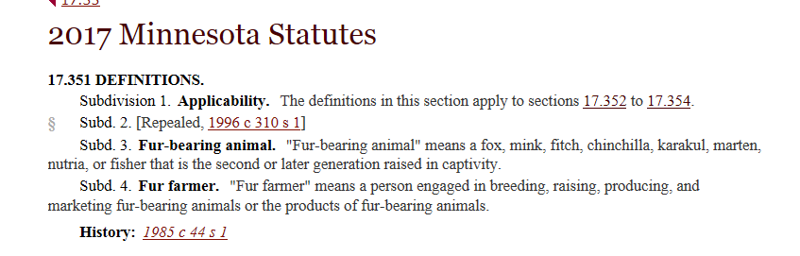
Fur Bearing Animals
Fur Bearing Animals
Notes:
Production for the sale of .. Fur Bearing Animals. Most common is Mink
Some definitions and license requirements found in other statutes.
Ag classification Statute does not list license as a condition – but other Statutes do require licensure.

Slide 39
Insects that are primarily bred to be used as food for animals
Added 1999 -
insects that are primarily bred to be used as food for animals
Notes:
I have a foggy memory of Crickets ….

Slide 40
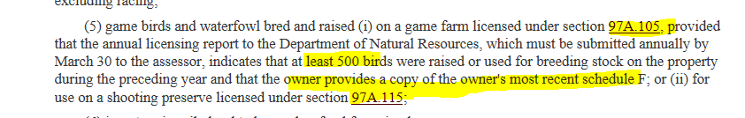
Game birds and waterfowl for game farms / shooting preserves
At least 500 birds the preceding year | Schedule F
Annual licensing report to assessor by March 30 | Raised onsite of Game Farm licensed under 97A.105
Game birds and waterfowl for/on game farms - Conditional
Production may occur on or off the Shooting Preserve, but must be raised for use on a Shooting Preserve licensed under 97A.115
Notes:
Two separate and distinct birds. Ok the Birds can be the same, Gamebirds and waterfowl, (Pheasants, quail, turkeys, ducks, geese etc..).. The requirements are distinct.
The first option - requires 4 conditions be met 1) the production take place on a game farm licensed under section 97A.105. 2) must produce at least 500 birds annually, 3) owner must provide most recent schedule F, and 4) Owner must provide assessor with annual report. (This definition may have been targeted towards a producer selling to Zoo’s)
The Second Option – Requires only one condition be met - 1) The bird be raised for use on a shooting reserve licensed under 97A.115 (This definition was targeted towards those targeting birds)

Slide 41
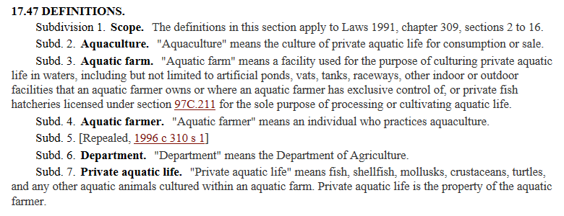
Aquaculture - Conditional
(2) aquaculture products for sale and consumption, as defined under section 17.47, if the aquaculture occurs on land zoned for agricultural use;
On Land Zoned for Agricultural use
Aquaculture - Conditional
Notes:
Something fishy – Conditional … licensed and on land zoned for ag

Slide 42
Commercial Boarding of Horses - Conditional
commercial boarding of horses, which may include related horse training and riding instruction, if the boarding is done on property that is also used for raising pasture to graze horses or raising or cultivating other agricultural products as defined in clause (1); It is the expectation that the training and riding instruction related to the commercial boarding is that which is provided to those individuals who are boarding their horses onsite. If the training and riding instruction are provided to the general
public (e.g. those who do not board their horses onsite) that portion of the property would be classified as commercial.
Commercial Boarding of Horses - Conditional
Notes:
Next Slide simplifies
Differentiate when Commercial Boarding of Horses is Ag, and when Associated training and riding lessons are Ag and when those Activities Are Commercial

Slide 43
Whose Horse is it?
Property has >10 acres pasture for Grazing Horses and/or other Defined Ag Products
Commercial Boarding of Horses
May include Horse Training and riding Instruction
When Provided to those individuals who are boarding their horses onsite
Agricultural
Commercial Boarding of Horses - Conditional
If the training and riding instruction are provided to the general public (e.g. those who do not board their horses onsite) that portion of the property would be classified as commercial.
Notes:
Less Words .. Same meaning

Slide 44
Nonprofit equestrian organization - Conditional
(4) property which is owned and operated by nonprofit organizations used for equestrian activities, excluding racing
Nonprofit equestrian organization - Conditional
Differentiate Human activities versus Equestrian. Split Class Campgrounds/ picnic areas/ shelters appropriately. Acreage = Areas used for Equestrian activities
Notes:
No Racing

Slide 45
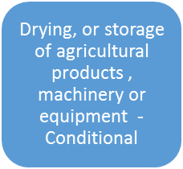
Drying, or storage of agricultural products , machinery or equipment - Conditional “By The Owner”
"Agricultural purposes" as used in this section means the raising, cultivation, drying, or storage of agricultural products for sale, or the storage of machinery or equipment used in support of agricultural production by the same farm entity.
By the same Farm Entity
For a property to be classified as agricultural based only on the drying or storage of agricultural products, the products being dried or stored must have been produced by the same farm entity as the entity operating the drying or storage facility.
Notes:
Clarifies Custom Storage / Drying versus farmer owned

Slide 46
Agricultural Purposes – 20 defined uses apply to 273.13 Subd.23 (e) (1)
17 - Apparent
Production For the Sale of:
4 - Obscure
Participation of Qualified Acreage in Qualified Conservation Programs
Notes:
Transition from Apparent uses to obscure – Still within 273.13 subd.23 (e) (1)

Slide 47
Obscure Agricultural Purposes– Typical Characteristics
Administrative
Unit Of Government Manages
Following a Conservation Plan
Recorded Easement or Unrecorded Contract
Physical
In production prior to enrollment
Planted to Native Prairie, Trees, Forbes, Flowers, or introduced habitat
Often Appears Non-Productive – Not Harvested
Acreages Large to Small
Payment one time or annual
Assessment
Must have been 2a land prior to enrollment

Slide 48
Qualified Acreage
property was classified as agricultural property since the 2002 assessment; (Grandfather Clause)
property was classified as agricultural property in the year prior to its enrollment in the conservation program
OR
Notes:
Conservation Programs only continue 2a classification – they do not initiate. A property will never switch from some other class, to 2a, due to participation in a Conservation program.

Slide 49
Conservation Program
Qualifying Program
RIM
CRP
Local
Other Similar
Notes:
Four categories

Slide 50
Reinvest In Minnesota
State Program.
Board of Water and Soil Resources Oversees
Soil and Water Conservation District Administer
Recorded Conservation Easement
Binding to the Property
Documentation includes map
Perpetual option
Typically one time payment
RIM
Notes:
Started 1985, Recorded Document you can access

Slide 51
Conservation Reserve Program
Federal Government (USDA) Program
Natural Resource Conservation Service (NRCS) and Farm Service Agency (FSA) administer.
Contract with Annual Payments.
Contract binding to owner who enrolls.
Continuation in program optional with change in ownership.
Contract minimum 10 years, will have a expiration date.
Many programs under the “CRP” Umbrella
CREP is a CRP program with a state Enhancement
CRP
Notes:
Information not public from FSA – Owner can get documentation for you

Slide 52
Similar state or federal conservation program
Flexibility to allow for changing acronyms.
In production and classified ag prior to enrollment.
Administered by State or Federal agency
Prohibit farming.
Other Similar
Notes:
Thorough documentation – know what it is, check with other counties - PTCO

Slide 53
Local conservation programs
a "local conservation program" means a program administered by a town, statutory or home rule charter city, or county, including a watershed district, water management organization, or soil and water conservation district
Local
The Landowner must:
receive annual payments of at least $50 per acre in exchange for use or other restrictions on the land.
apply to the assessor by February 1 of the assessment year.
submit information required by the assessor including a copy of program requirements, the agreement between land owner and the local agency, and a map of the conservation area.
Notes:
Note February 1 Deadline

Slide 54
And then …. Left Overs
2a Inclusions
2b Split Class
Property that does not meet 2a definition which is included within 2a classification typically less than 10 acres. Inclusion acres do NOT count toward meeting the initial 10 acre minimum.
Rural Vacant land typically greater than 10 acres
House Garage and One Acre
Other Classes including Commercial, Industrial, Residential, 2c managed forest etc..
10 Acre Guideline:
Pursuant to DOR guidance, common practice is contiguous class 2b land masses, 10 acres or more in size, should be considered practical to separate from 2a land, while contiguous land masses less than 10 acres in size should be considered impractical to separate.
Notes:
Accounting for all acres discuss 10 acre guideline.

Slide 55
Left Overs – 2a Inclusion
If there is a land mass of at least 10 contiguous acres that has been used during the preceding year to produce an agricultural product for sale, it is classified as 2a land.
Once this determination is made, any land deemed “impractical to separate” and any other smaller land masses of class 2a land on the same parcel may be classified as class 2a land as well.
Class 2a land must also contain any property that would otherwise be classified as 2b rural vacant land, but is interspersed with class 2a property. This includes but is not limited to sloughs, wooded wind shelters, acreage abutting ditches, ravines, rock piles, land subject to a setback requirement, and other similar land that is impractical for the assessor to value separately from the rest of the property or that is unlikely to be able to be sold separately from the rest of the property.
Notes:
Land that gets thrown in with 2a ONLY after there is 10 acres 2a

Slide 56
2a - lakes, rivers, and streams
Notes:
Lakes River Streams 2a Buffer

Slide 57
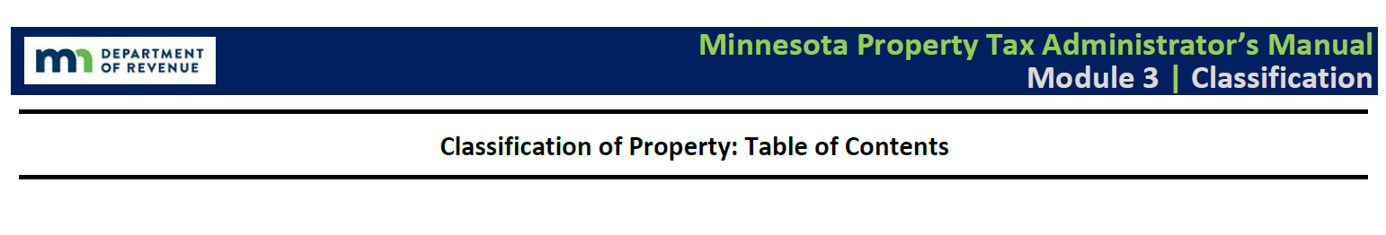
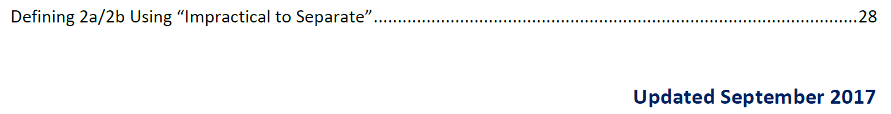
Left Overs -2b Split Class
The general guideline is contiguous class 2b land masses, 10 acres or more in size, should be considered practical to separate from 2a land, while contiguous land masses less than 10 acres in size should be considered impractical to separate.
Exceptions and Variations to the General Guideline – Refer to the manual
Notes:
Variation from the 10 acre guideline .. Reference Property tax manual, Module 3

Slide 58
Left Overs – Homestead implications
2a
Interspersed non-productive
Field/Pasture etc..
2b
Non –productive >10 acres
CRP/RIM etc..
H.G.A.
Class 2b land may qualify as part of an agricultural homestead (without regard to parcel lines) if it is contiguous to qualifying class 2a agricultural land under the same ownership. The class 2b land would be included in the agricultural homestead classification rates and tiers.
Notes:
2a and contiguous 2b may qualify for homestead. Parcel Lines do not break contiguity.

Slide 59
2a – Four Statutory Categories
10 or more contiguous Acres Agricultural Purposes -273.13 subd.23 (e) (1)
10 -10.99 Acres No Dwelling and 11 plus acres with or without dwelling.
Less than Ten acres Exclusively used for Agricultural Purposes – 273.13 subd.23 (f) (1)
Less than 11 acres including a dwelling 273.13 subd.23 (f) (2)
Less than 10 acres No Dwelling.
Intensive Livestock or Poultry Confinement Operation – 273.13 subd.23 (e) (2)
Property of any Acreage, with or without dwelling.
Less than 11 acres with a dwelling.
Notes:
The Four categories, only four there are no more. – Intensive Confinement.

Slide 60
Some times you find …
Intensive Livestock or Poultry Confinement Operation – 273.13 subd.23 (e) (2)
  Property of any Acreage, with or without dwelling.
Notes:
A lot of animals in a confined area.

Slide 61
2a Classification Wild Card
The use of the property for intensive livestock or poultry confinement is the driving characteristic to agricultural classification, rather than number of acres used for such purpose.
Property of any acreage used for intensive livestock or poultry confinement is considered class 2a agricultural land (i.e., the acres used for the confinement activity).
The property may be homesteaded as agricultural land, but is not eligible for Green Acres unless it meets the minimum 10 acre requirement (M.S. 273.111).
Supersedes 273.13 Subd.23 (f) (2) relating to parcels of less than 11 acres containing a residence
Notes:
Wild Card

Slide 62
From the Property Tax Administrators Manual
Intensive Livestock or Poultry Confinement
Contiguous acreage used during the preceding year for intensive livestock or poultry
confinement is also agricultural – regardless of the actual number of acres used for the
confinement. Property used for intensive livestock or poultry confinement may be agricultural
also regardless of the size of the parcel the confinement activity is located on. The property
may be homesteaded as agricultural land, but would not be eligible for Green Acres unless the
requirements for Green Acres – including 10 acres used for agricultural purposes – are met
Statute reads
contiguous acreage used during the preceding year for an intensive livestock or poultry confinement operation, provided that land used only for pasturing or grazing does not qualify under this clause.
Notes:
Narratives -

Slide 63
Subjective Variables
Intensive
Confinement
Pasture
Notes:
You know it when you see it – but be prepared for borderline cases and gray areas. What is the difference between Pasture and Confinement? Intensive by what measure?

Slide 64
A Resource for consideration – NOT a requirement for Ag Class
Producers operating intensive livestock or poultry confinement facilities are subject to MPCA oversight either directly or through county delegates.
All intensive livestock or poultry confinement facilities should be Registered HOWEVER Not all registered feedlots are intensive livestock or poultry confinement facilities.
Feedlot registration does NOT EQUATE production. The Assessor must verify production in the preceding year.
Feedlot registration information related to definitions and registration requirements is provided to assist with communication between assessors and producers.
Notes:
Discussion on MPCA registration

Slide 65
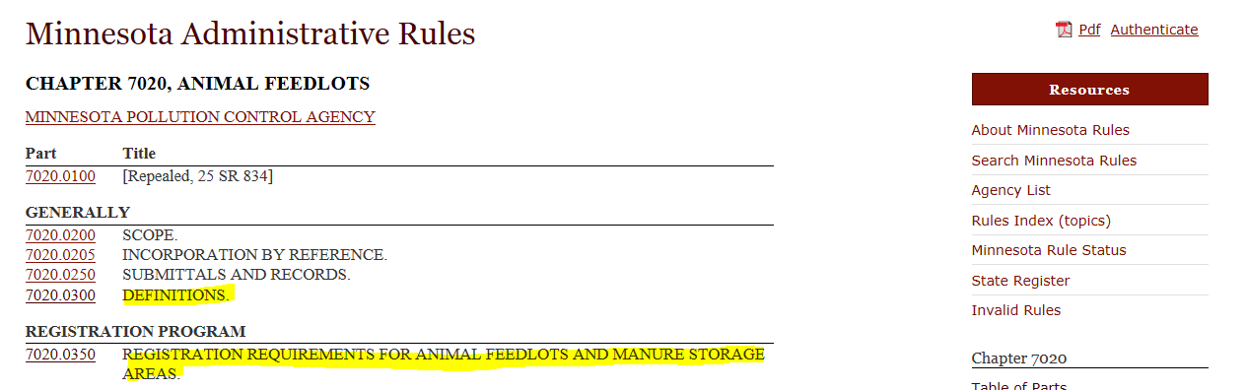
A Resource for consideration
Notes:
MPCA Administrative Rules

Slide 66

A Resource for consideration
2017 Minnesota Statutes
273.13 CLASSIFICATION OF PROPERTY.
Subd. 23.Class 2. (e) Agricultural land as used in this section means:
(2) contiguous acreage used during the preceding year for an intensive livestock or poultry confinement operation, provided that land used only for pasturing or grazing does not qualify under this clause.
Minnesota Administrative Rules
Rules>Pollution Control Agency>Chapter 7020> Part 7020.0300
7020.0300 DEFINITIONS
Subp. 3. Animal feedlot.
"Animal feedlot" means a lot or building or combination of lots and buildings intended for the confined feeding, breeding, raising, or holding of animals and specifically designed as a confinement area in which manure may accumulate, or where the concentration of animals is such that a vegetative cover cannot be maintained within the enclosure. For purposes of these parts, open lots used for the feeding and rearing of poultry (poultry ranges) shall be considered to be animal feedlots. Pastures shall not be considered animal feedlots under these parts.
Notes:
Comparison of classification language and PCA animal feedlot definition. PCA definition is more descriptive which can be useful. Pasture excluded from both

Slide 67
A Resource for consideration
Pasture
Minnesota Administrative Rules
7020.0300 DEFINITIONS
Subp. 18. Pastures. "Pastures" means:
A. areas, including winter feeding areas as part of a grazing area, where grass or other growing plants are used for grazing and where the concentration of animals allows a vegetative cover to be maintained during the growing season, except that vegetative cover is not required:
(1) in the immediate vicinity of supplemental feeding or water devices;
(2) in associated corrals and chutes where livestock are gathered for the purpose of sorting, providing veterinary services, loading and unloading trucks and trailers, and other necessary activities related to good animal husbandry practices; or
(3) in associated livestock access lanes used to convey livestock to and from areas of the pasture; or
B. agricultural land:
(1) where livestock are allowed to forage during the winter;
(2) that is used for cropping purposes in the growing season; and
(3) where the concentration of animals is such that a vegetative cover, whether of grass, growing plants, or crops, is maintained during the growing season, except in the immediate vicinity of temporary supplemental feeding or watering devices.
“provided that land used only for pasturing or grazing does not qualify under this clause.” 273.13 Subd.23 (e) (2)
Notes:
Pasture definition from PCA. Language from 273.13 related to pasture. Note: winter feeding areas and vegetative cover discussion, a winter feeding area combined within a pasture may not be “intensive animal confinement”

Slide 68
A Resource for consideration
Intensive
Minnesota Administrative Rules
7020.0300 DEFINITIONS
Subp. 5. Animal unit. "Animal unit" means a unit of measure used to compare differences in the production of animal manure that employs as a standard the amount of manure produced on a regular basis by a slaughter steer or heifer for an animal feedlot or a manure storage area, calculated by multiplying the number of animals of each type in items A to I by the respective multiplication factor and summing the resulting values for the total number of animal units. For purposes of this chapter, the following multiplication factors shall apply:
A. dairy cattle:
(1) one mature cow (whether milked or dry):
(a) over 1,000 pounds, 1.4 animal unit; or
(b) under 1,000 pounds, 1.0 animal unit;
(2) one heifer, 0.7 animal unit; and
(3) one calf, 0.2 animal unit;
B. beef cattle:
(1) one slaughter steer or stock cow, 1.0 animal unit;
(2) one feeder cattle (stocker or backgrounding) or heifer, 0.7 animal unit;
(3) one cow and calf pair, 1.2 animal unit; and
(4) one calf, 0.2 animal unit;
C. one head of swine:
(1) over 300 pounds, 0.4 animal unit;
(2) between 55 pounds and 300 pounds, 0.3 animal unit; and
(3) under 55 pounds, 0.05 animal unit;
D. one horse, 1.0 animal unit;
E. one sheep or lamb, 0.1 animal unit;
F. chickens:
(1) one laying hen or broiler, if the facility has a liquid manure system, 0.033 animal unit; or
(2) one chicken if the facility has a dry manure system:
(a) over five pounds, 0.005 animal unit; or
(b) under five pounds, 0.003 animal unit;
G. one turkey:
(1) over five pounds, 0.018 animal unit; or
(2) under five pounds, 0.005 animal unit;
H. one duck, 0.01 animal unit; and
I. for animals not listed in items A to H, the number of animal units is the average weight of the animal in pounds divided by 1,000 pounds.
Notes:
Animal Units – units of measure related to animal weight and manure production. One 1,000 pound steer or stock cow equals one animal unit. Using the factors the equivalent number of animals needed to equal an animal unit can be calculated. This allows for establishing production benchmarks that can be applied to various and combined species.

Slide 69
A Resource for consideration
Intensive
Minnesota Administrative Rules
7020.0350 REGISTRATION REQUIREMENTS FOR ANIMAL FEEDLOTS AND MANURE STORAGE AREAS.
Subp. 2. Owners required to register.
A. Owners of the following facilities are required to register with the commissioner or delegated county, except as provided in item B:
(1) an animal feedlot capable of holding 50 or more animal units, or a manure storage area capable of holding the manure produced by 50 or more animal units; and
(2) an animal feedlot capable of holding ten or more and fewer than 50 animal units, or a manure storage area capable of holding the manure produced by ten or more and fewer than 50 animal units, that is located within shoreland.
B. An owner of a livestock facility located on county fairgrounds is not required to register, in accordance with Laws 2000, chapter 435, section 10, paragraph (c), clause (6).
Notes:
PCA threshold for Feedlot Registration – 10 animal units in shore land and 50 animal units outside shore land.

Slide 70
And then …. Left Overs
2a Inclusions
2b Split Class
Property that does not meet 2a definition which is included within 2a classification typically less than 10 acres. Inclusion acres do NOT count toward meeting the initial 10 acre minimum.
Rural Vacant land typically greater than 10 acres
House Garage and One Acre
Other Classes including Commercial, Industrial, Residential, 2c managed forest etc..
The general guideline is contiguous class 2b land masses, 10 acres or more in size, should be considered practical to separate from 2a land, while contiguous land masses less than 10 acres in size should be considered impractical to separate.
10 Acre guideline:
Notes:
Same as 10 or more contiguous Acres Agricultural Purposes -273.13 subd.23 (e) (1)

Slide 71
Left Overs – 2a Inclusion
If there is a land mass of at least 10 contiguous acres that has been used during the preceding year to produce an agricultural product for sale, it is classified as 2a land.
Once this determination is made, any land deemed “impractical to separate” and any other smaller land masses of class 2a land on the same parcel may be classified as class 2a land as well.
Class 2a land must also contain any property that would otherwise be classified as 2b rural vacant land, but is interspersed with class 2a property. This includes but is not limited to sloughs, wooded wind shelters, acreage abutting ditches, ravines, rock piles, land subject to a setback requirement, and other similar land that is impractical for the assessor to value separately from the rest of the property or that is unlikely to be able to be sold separately from the rest of the property.
Notes:
Same as greater than 10 acres

Slide 72
2a - lakes, rivers, and streams
Notes:
Same as greater than 10 acres

Slide 73
Left Overs -2b Split Class
The general guideline is contiguous class 2b land masses, 10 acres or more in size, should be considered practical to separate from 2a land, while contiguous land masses less than 10 acres in size should be considered impractical to separate.
Exceptions and Variations to the General guideline – Refer to the manual
Notes:
Same as greater than 10 acres

Slide 74
Left Overs – Homestead implications
2a
Interspersed non-productive
Field/Pasture etc..
2b
Non –productive >10 acres
CRP/RIM etc..
H.G.A.
Class 2b land may qualify as part of an agricultural homestead (without regard to parcel lines) if it is contiguous to qualifying class 2a agricultural land under the same ownership. The class 2b land would be included in the agricultural homestead classification rates and tiers.
Notes:
Same as greater than 10 acres

Slide 75
2a – Four Statutory Categories
10 or more contiguous Acres Agricultural Purposes -273.13 subd.23 (e) (1)
10 -10.99 Acres No Dwelling and 11 plus acres with or without dwelling.
Less than Ten acres Exclusively used for Agricultural Purposes – 273.13 subd.23 (f) (1)
Less than 11 acres including a dwelling 273.13 subd.23 (f) (2)
Less than 10 acres No Dwelling.
Intensive Livestock or Poultry Confinement Operation – 273.13 subd.23 (e) (2)
Property of any Acreage, with or without dwelling.
Less than 11 acres with a dwelling.
Notes:
The Four categories, only four there are no more. – Less than 10 acres exclusive Use

Slide 76
Real Estate of Less Than 10 Acres
  Less than 10 acres No Dwelling.
Less than Ten acres Exclusively used for Agricultural Purposes – 273.13 subd.23 (f) (1)
Notes:
Straight forward

Slide 77
From the Property Tax Administrators Manual
Real Estate of Less Than 10 Acres
Real estate of LESS THAN 10 acres that is exclusively used for agricultural purposes should be
considered to be agricultural land. “Exclusively” means the entire parcel, border-to-border is
used for an agricultural purpose – there is no house, no cabin, and no other use of the parcel. If
there is another use on the property, it is by definition not used exclusively for agricultural
purposes.
Statute reads
(1) contiguous acreage that is less than ten acres in size and exclusively used in the preceding year for raising or cultivating agricultural products
Notes:
Narrative

Slide 78
Agricultural Purposes
Includes the apparent and obscure uses as applied to contiguous tracts larger than 10 acres under 273.13 subd.23 (e) (1)
Notes:
Same as 10 or more contiguous Acres Agricultural Purposes -273.13 subd.23 (e) (1)

Slide 79
Some Particulars
Contiguous Definition
"Contiguous acreage," for purposes of this paragraph, means all of a tax parcel as described in section 272.193, or all of a set of contiguous tax parcels under that section that are owned by the same person
Implication – Consider all contiguous parcels
Homestead implications
May be linked as provided for in homestead statute, will not qualify for actively farming due to size.
Notes:
Remember all contiguous parcels – not to “cherry pick”

Slide 80
Leftovers, Split Class
NOT ALLOWED
Notes:
Exclusive use = no leftovers or split class

Slide 81
2a – Four Statutory Categories
10 or more contiguous Acres Agricultural Purposes -273.13 subd.23 (e) (1)
10 -10.99 Acres No Dwelling and 11 plus acres with or without dwelling.
Less than Ten acres Exclusively used for Agricultural Purposes – 273.13 subd.23 (f) (1)
Less than 11 acres including a dwelling 273.13 subd.23 (f) (2)
Less than 10 acres No Dwelling.
Intensive Livestock or Poultry Confinement Operation – 273.13 subd.23 (e) (2)
Property of any Acreage, with or without dwelling.
Less than 11 acres with a dwelling.
Notes:
The Four categories, only four there are no more. Less than 11 acres with a dwelling

Slide 82
Most limited
Less than 11 acres including a dwelling 273.13 subd.23 (f) (2)
Note: Properties of less than 11 acres including a residence, that qualify for Ag due to intensive livestock or poultry confinement under 273.13 Subd.23 (e) (2), are not subject to the requirements of this provision -273.13 Subd.23 (f) (2)
Notes:
Only Three Uses, Note: Intensive Livestock Poultry Confinement may qualify less than Eleven Acres with a Dwelling as addressed earlier.

Slide 83
Exclusive Uses
Statute Reads -“contiguous acreage that contains a residence and is less than 11 acres in size, if the contiguous acreage exclusive of the house, garage, and surrounding one acre of land was used in the preceding year for one or more of the following three uses:”
The entire contiguous acreage (exclusive of the house, garage and surrounding one acre) must be used for one or more, of three specified uses in the preceding year. Meeting the use requirement on a portion of the remaining contiguous property or on a specific building DOES NOT qualify a property, or any portion thereof, to be 2a under this provision.
Contiguous acreage," for purposes of this paragraph, means all of a tax parcel as described in section 272.193, or all of a set of contiguous tax parcels under that section that are owned by the same person, consider all contiguous parcels.
Notes:
Key Point -requires “contiguous acres” to be used for a specific purpose which equates to Exclusive Use. – Dwelling and one or more of three defined Agricultural uses.

Slide 84
Three Uses – All Conditional
One or more of Three uses
Intensive grain drying, Intensive Grain, Machinery, equipment storage.
Intensive Nursery
Market Farming
Notes:
Each of the three uses have conditions

Slide 85
Contains a residence.
Remaining Contiguous acreage used in the preceding year for one or more of Three defined Uses.
for an intensive grain drying or storage operation, or for intensive machinery or equipment storage activities used to support agricultural activities on other parcels of property operated by the same farming entity;
Intensive grain drying, Intensive Grain, Machinery, equipment storage.
Notes:
Remaining contiguous acres = exclusive use other than house and garage

Slide 86
Requires the Same Farm Entity To:
Own the parcel with the residence
Operate intensive grain drying or intensive grain, machinery, equipment storage activities
Support Ag activities on other properties farmed by that entity*
Intensive grain drying, Intensive Grain, Machinery, equipment storage.
*Other properties operated by the entity do not have to be owned by the Farm Entity
Notes:
“same farming entity” applies to: own, operate, and farm

Slide 87
Contains a residence.
Remaining Contiguous acreage used in the preceding year for one or more of Three defined Uses.
as a nursery, provided that only those acres used intensively to produce nursery stock are considered agricultural land;
Intensive Nursery
18H.02 DEFINITIONS.
Subd. 20.Nursery stock. "Nursery stock" means a plant intended for planting or propagation, including, but not limited to, trees, shrubs, vines, perennials, biennials, grafts, cuttings, and buds that may be sold for propagation, whether cultivated or wild, and all viable parts of these plants. Nursery stock does not include:
(1) field and forage crops or sod;
(2) seeds;
(3) vegetable plants, bulbs, or tubers;
(4) cut flowers, unless stems or other portions are intended for propagation;
(5) annuals; or
(6) Christmas trees.
Notes:
Note intensively requirement – Nursery Stock .. Horticultural stock is not included.

Slide 88
Contains a residence.
Remaining Contiguous acreage used in the preceding year for one or more of Three defined Uses.
Market Farming
Product must be sold by the farmer, or an organization the farmer is affiliated with, to a local market
for intensive market farming; for purposes of this paragraph, "market farming" means the cultivation of one or more fruits or vegetables or production of animal or other agricultural products for sale to local markets by the farmer or an organization with which the farmer is affiliated.
Notes:
Market Farming – conditional products sold to local markets – by the farmer or an organization the farmer is affiliated with. Selling produce to a restaurant would not qualify.

Slide 89
Leftovers, Split Class
There are no leftovers, the contiguous acreage exclusive of the house, garage, and surrounding one acre of land must be used exclusively for one or more of the three defined uses, all of which are 2a.
The only Split class allowed is for the HGA, which is classified according to use.
Homestead as provided for in homestead statute, will not qualify for actively farming due to size.
uses which are 2a for other categories will disqualify for this category (otherwise would conflict with – 273.13 subd.23 (f) (1)- Exclusive use)
Disqualifier
Additional home sites
Other types of Agricultural Uses
Commercial/Industrial
Rural Vacant Land or any other use
Notes:
Leftovers, Split Class, homestead – Note: uses which are 2a for other categories will disqualify for this category (otherwise would conflict with – 273.13 subd.23 (f) (1)- Exclusive use)

Slide 90
The Four categories, only four, there are no more.
10 or more contiguous Acres Agricultural Purposes -273.13 subd.23 (e) (1)
10 -10.99 Acres No Dwelling and 11 plus acres with or without dwelling.
Less than Ten acres Exclusively used for Agricultural Purposes – 273.13 subd.23 (f) (1)
Less than 11 acres including a dwelling 273.13 subd.23 (f) (2)
Less than 10 acres No Dwelling.
Intensive Livestock or Poultry Confinement Operation – 273.13 subd.23 (e) (2)
Property of any Acreage, with or without dwelling.
Less than 11 acres with a dwelling.
Notes:
The Four categories, only four there are no more. –

Slide 91
Fine Print – 273.124 Subd. 14
In The Homestead Statute, there is a Grandfather Clause for Properties which qualified for the 1998 assessment
273.124 Subd. 14. Agricultural homesteads; special provisions. (a) Real estate of less than ten acres that is the homestead of its owner must be classified as class 2a under section 273.13, subdivision 23, paragraph (a), if:
(1) the parcel on which the house is located is contiguous on at least two sides to (i) agricultural land, (ii) land owned or administered by the United States Fish and Wildlife Service, or (iii) land administered by the Department of Natural Resources on which in lieu taxes are paid under sections 477A.11 to 477A.14;
(2) its owner also owns a noncontiguous parcel of agricultural land that is at least 20 acres;
(3) the noncontiguous land is located not farther than four townships or cities, or a combination of townships or cities from the homestead; and
(4) the agricultural use value of the noncontiguous land and farm buildings is equal to at least 50 percent of the market value of the house, garage, and one acre of land.
Homesteads initially classified as class 2a under the provisions of this paragraph shall remain classified as class 2a, irrespective of subsequent changes in the use of adjoining properties, as long as the homestead remains under the same ownership, the owner owns a noncontiguous parcel of agricultural land that is at least 20 acres, and the agricultural use value qualifies under clause (4). Homestead classification under this paragraph is limited to property that qualified under this paragraph for the 1998 assessment.

Slide 92
Agricultural Production and Purposes
Applying 273.13 Subd 23

