Slide 1
Following Alice Through the Looking Glass:
A Case Study on How Not to Measure Functional Obsolescence in Large Retail Properties

Slide 2
Menards v. County of Clay, (2015-2016) Tax Court, Judge Delapena
MN Supreme Court Approves
The Tax Court deducts $2,500,000 as “a reasonable estimate of functional obsolescence … for the approximate cost of converting a recently constructed Lowe’s home improvement store to a Mills Fleet Farm home improvement store.” Supreme Court affirms.

Slide 3
Menards v. County of Anoka, (2019)
Tax Court, Judge Delapena
Both of the appraisers testified that the Court should deduct $2,500,000 “for rebranding the store.” The Tax Court said “These post-sale improvements (removal of expensive trade dress) fit within the definition of functional obsolescence.”

Slide 4
Lowe’s Home Centers (Plymouth) v. County of Hennepin, (2019-2020)
Tax Court, Judge Gronvall
MN Supreme Court Approves
The Supreme Court stated:
  “[T]he tax court properly looked at our decision in Menard to analyze the value of a comparable’s post-sale improvements to find the subject’s functional depreciation. [T]he tax court adopted a $2.5 million value.”

Slide 5
Shopko Stores v. Chisago County, 2019 Tax Court, Judge Delapena
The Petitioner’s appraiser documents states “that Mills spent $2.5 Million, or $19.67 per square foot, to rebrand a former 127,082 square-foot Lowe’s home improvement store.”

Slide 6
Defining functional obsolescence as “Incompetent” or “Inability”
Long before it decided Menard (Clay), the Minnesota Supreme Court had defined functional obsolescence as “the inadequacy or obsolescence of a facility due to developments which have made it incompetent to perform its function properly or economically, *** or the inability of a structure to perform adequately the function for which it is currently employed.”
Empire State Bank v. Lyon Cty. (1990)

Slide 7
Defining functional obsolescence as a “flaw” in the structure, materials, or design
Appraisal Institute, The Appraisal of Real Estate 576 (14th ed. 2013) defines functional obsolescence as “a flaw in the structure, materials, or design that diminishes the function, utility, and value of the improvement.”

Slide 8
Superadequacies
The Minnesota Supreme Court has also recognized superadequacies in a building’s structure, materials, or design as functional obsolescence; see also Appraisal of Real Estate (noting that functional obsolescence can be caused “by a superadequacy–that is, some aspect of the subject property [that] exceeds market norms”).

Slide 9
The Tax Court Acknowledges Trade Dress as “Functional Obsolescence”
In Menard (Clay), the Supreme Court commented: “[E]xpensive trade dress [that is] so important to [one big-box] retailer represents functional obsolescence when the property is put on the open market.”
In adopting [the] view that a former property owner’s trade dress is a superadequacy constituting functional obsolescence, the supreme court was simply applying an established theory of functional obsolescence to a new fact situation. The court’s holding was quite specific: the removal of expensive trade dress “fit within the definition of functional obsolescence.”

Slide 10
The Tax Court Narrows Its Test
We conclude that the proper measure of this form of functional obsolescence is the cost to remove the trade dress and to convert the affected area into generic big box retail space.

Slide 11
Functional obsolescence and expenditures after sale may be different things
“[T]he County contends that the Minnesota courts—contrary to Mr. Lennhoff’s text and intention—have unwittingly treated as functional obsolescence all expenditures after sale, rather than just those expenditures to remove branding elements that Lennhoff discusses.”

Slide 12
Deductions for functional obsolescence require proof of why the expense was incurred
“[T]he County asks us not to use the Mills renovation to estimate functional obsolescence here, because Mr. Vergin’s analysis demonstrates that Mills’ post-sale expenditures were directed almost entirely to expanding and rebuilding the store, rather than to removing branding elements (or addressing) other functional obsolescence.”

Slide 13
Excerpts from the Appraisal:
Since the tax court is familiar with the former Lowe’s property sale in Cambridge, we have analyzed this property.
The tax court utilized functional obsolescence of $1,572,951 for the subject property. This was based upon the sales of the former Lowe’s that was converted to a Mills Fleet Farm (sold in October of 2012 for $5,000,000). According to the tax court, Mills Fleet Farm spent $2.5 million or $19.67 per square foot to rebrand a former 127,082 square-foot Lowe's home improvement store. The figure of $19.67 per square foot was applied to the subject’s main floor building area of 79,967 square feet to arrive at a functional obsolescence of $1,572,951.

Slide 14
Based upon our analysis, the use of one comparable to derive functional obsolescence is flawed for the reasons listed below.
First, the expenditures after sale included expanding the subject property and adding a silo to the store, which is only utilized in Mills Fleet Farm stores.
Second, Mills Fleet Farm tore down the 31,405 square foot garden center and constructed an automotive center and enclosed warehouse. This is considered expansion and construction, which consisted of building new exterior walls and footings, a roof, drive through doors, floor drains, etc. New construction and expansion of a property is not considered functional obsolescence.

Slide 15
In addition, Mills Fleet Farm constructed an enclosed lumberyard and kiosk building on the northern part of the property along with new asphalt paving, concrete paving, and perimeter fencing. This is considered an expansion of the property and not functional obsolescence.

Slide 16
The City of Cambridge building permits total $2,816,756 and are listed as mechanical, plumbing, and building remodel. The CEO of Mills Fleet Farm, Mr. Jeff Meeks, was interviewed on November 20, 2014 and December 1, 2014 for another assignment. Mr. Meeks indicated they had planned $2.8 million in costs for work to be incurred after the sale of the Mills Fleet Farm (formerly Lowe’s). This coincides with the building permits cost of $2,816,756.

Slide 17
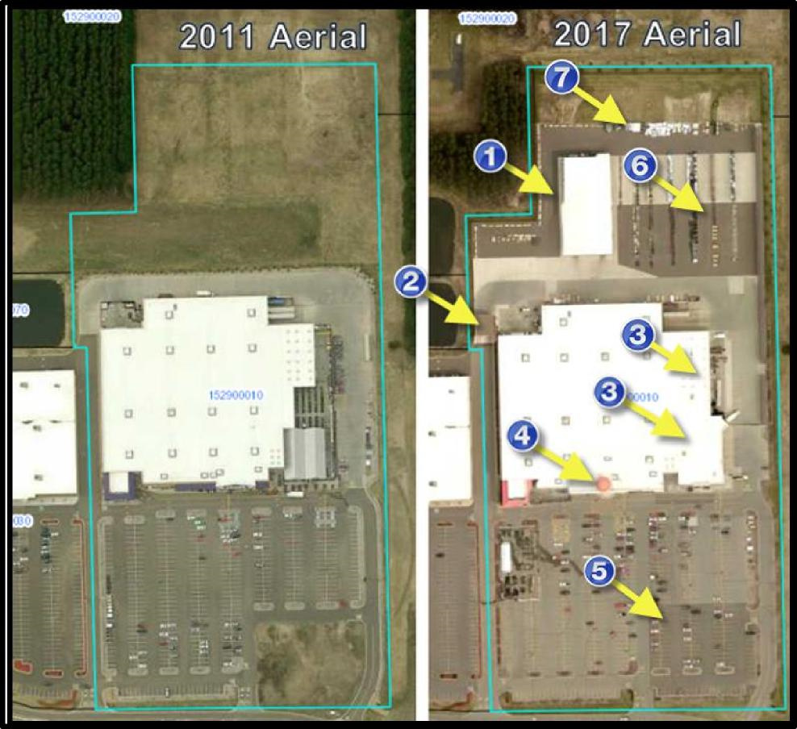
Before and After – Aerial Photographs from Isanti County GIS

Slide 18
AFTER Aerial Expansion Cost Items
1. New enclosed lumberyard constructed.
2. New kiosk/security building constructed.
3. Demolition of garden center and construction of automotive center
and enclosed warehouse.
4. Addition of the Mills Fleet Farm silo.
5. New asphalt paving.
6. Concrete paving constructed on the north side of the main
building.
7. 19.5 foot fence constructed on the northern portion of the
property.

Slide 19
