Slide 1
A DEEPER DIVE INTO THE ASSESSMENT TIMELINE
Mark Buysse | Lyon county assessor | markbuysse@co.lyon.mn.us
Jean nelson | pipestone county assessor | Jean.Nelson@pcmn.us
Bonnie lay | pope county deputy assessor | bonnie.lay@popecountymn.gov

Slide 2

Name? what county are you from? What's your position? Years in position?

Slide 3
references
Minnesota department of revenue – revenue.state.mn.us
Property tax administrator’s manual
Auditor/treasurer manual
Minnesota association of assessing officers – mnmaao.org
Education for Minnesota assessors
Mndor letters
Minnesota legislature (Minnesota statutes) - revisor.mn.gov/statutes
Minnesota state board of assessors - www.revenue.state.mn.us/minnesota-state-board-assessors

Slide 4
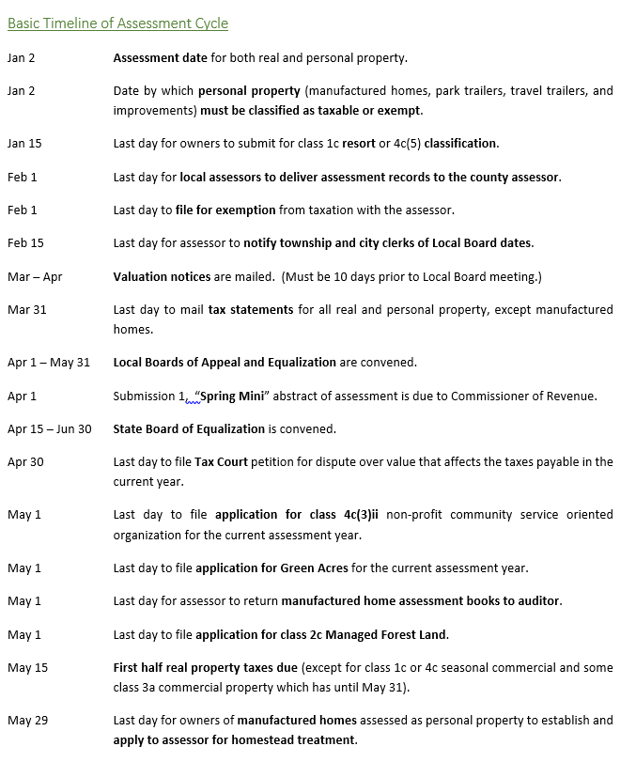
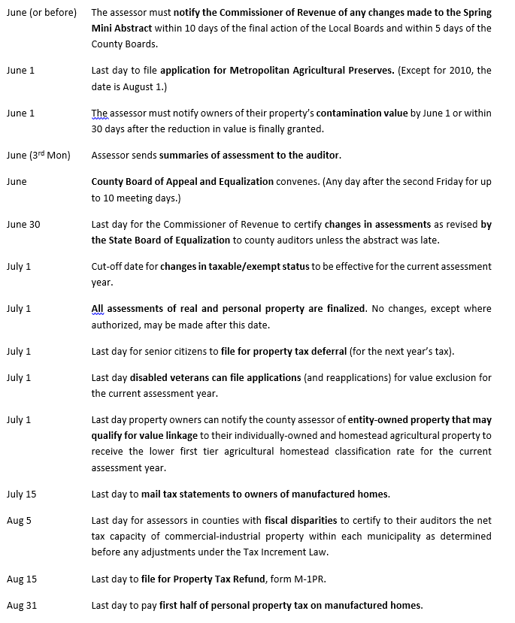
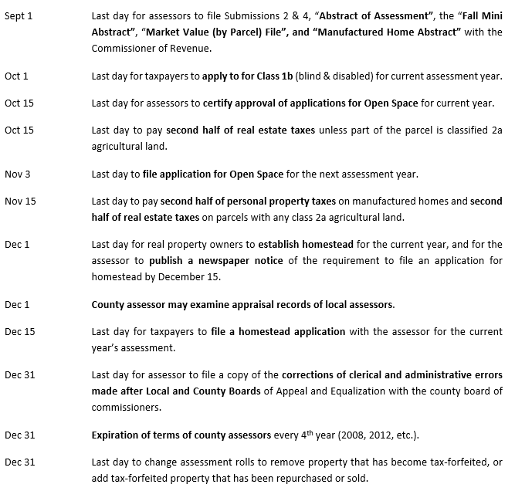
Basic timeline

Slide 5
Let’s break it down
January
January 2nd – assessment date for both real and personal property
Assessors must view properties at least once every five years
Value
Classify according use. When no apparent use, highest and best use
January 2nd
Personal property (manufactured homes, park trailers, travel trailers, and improvements) must be classified as taxable or exempt
January 15th
last day for owners to submit for class 1c resort or 4c(5) classification

Slide 6
January
Looking forward
Determine and send proposed LBAE and Cbae dates and times to each jurisdiction (due Feb. 15th).
some county’s may start in December to allow townships/cities time to present dates at local meetings in January.
The county board may meet on any ten consecutive meeting days in June after the 2nd Friday in June. All board must adjourn no later than june 30TH. (SEE NEXT SLIDE FOR EXAMPLE)
No action taken by the cbae after june 30th is valid, except for corrections that are clerical in nature or changes that extend homestead treatment until the tax extension date for that assessment year.

Slide 7
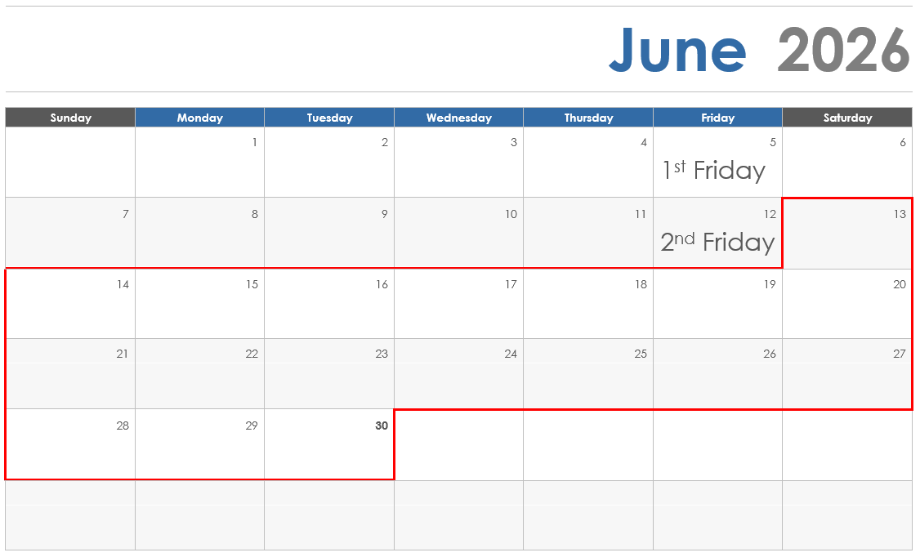
CBAE MUST BE HELD UNTIL 7:00 OR ON A SATURDAY. IF A COUNTY DOES NOT HOLD A MEETING UNTIL 7:00 PM THEY MUST INSTEAD HOLD A MEETING ON A SATURDAY. THIS IS TO ENSURE PROPERTY OWNERS HAVE AMPLE TIME TO PRESENT THEIR APPEALS. TIME REQUIREMENT EXCEPTIONS APPLY IF HELD ON SATURDAY. SEE BAE HANDBOOK

Slide 8
January
Looking forward
VERIFY all City administrators/township clerks are still current TRAINED MEMBERS
Check the lbae and cbae trained member roster on the mndor website. https://www.revenue.state.mn.us/board-appeal-and-equalization
Periodic reminders will be sent from the mndor multiple times throughout the year.
For in person bae’s, there must be at least one trained member. If there is not a trained member, The jurisdiction would lose its local board for a minimum of two years and then they would need to provide proof of compliance and a resolution to the County Assessor by February 1 of the assessment year they want to reinstate their board powers.
it is in the counties best interest to send TIMELY reminders.
(BOARD OF APPEAL AND EQUALIZATION HANDBOOK PAGE 4)

Slide 9
January
Looking forward
Create new year in tax system (if not already done)
Establish contract assessing fee amounts for townships/cities for the next assessment year. (If your county is true county, this may not apply to you.)
Social security edit listing
Run social security edit listings to ensure there are no false homesteads in your county
If there are duplicates, review. May want to run this multiple times throughout year to identify discrepancies.

Slide 10
January
Looking forward
Assessor disclosure form
The code of conduct and ethics prohibits assessors from accepting appraisal assignments in which the assessor is related to the owner as a spouse, parent, or child, by blood or by marriage, or in which the assessor has a financial or other interest in the property.

Slide 11
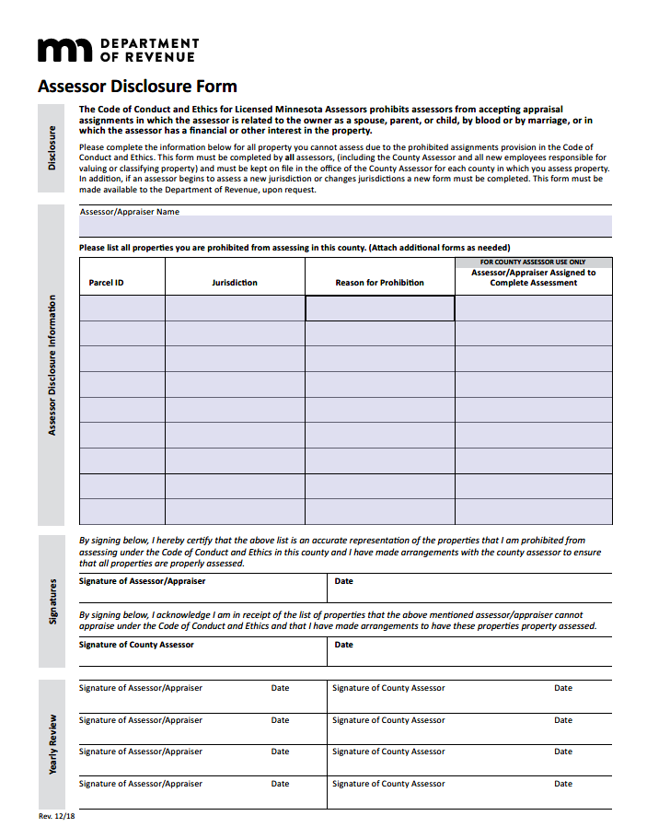

Slide 12
January
Looking forward
Data privacy (Minnesota Statutes 13.51, 273.061, subd. 8a)
It is highly recommended to have all assessors review their county data privacy policy. A signature from each assessor is also recommended acknowledging they have read and understand the polices.

Slide 13
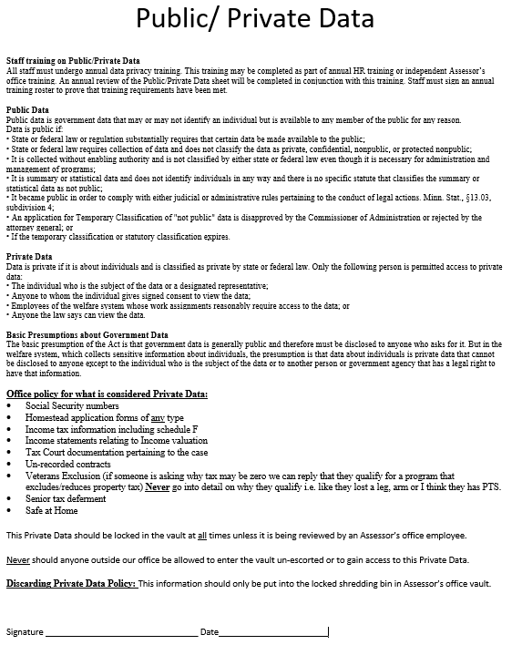
Notes:
Pope County Public/Private Data Policy.

Slide 14
January
What else should you know
Update any new year dates and information on county website
New construction as of January 2
Double check all new construction is complete. If not complete, run listing of percentage remaining along with a listing.
Proof all Homestead applications for current year tax
Own and occupy by December 31st
Remove any homesteads not applied for by statutory deadline
Request native prairie, managed forest and sfia lists from dnr and verify records in system are correct
Verify corporate farm list (Minnesota Department of Agriculture)
Finalize valuations and classifications for current assessment year

Slide 15
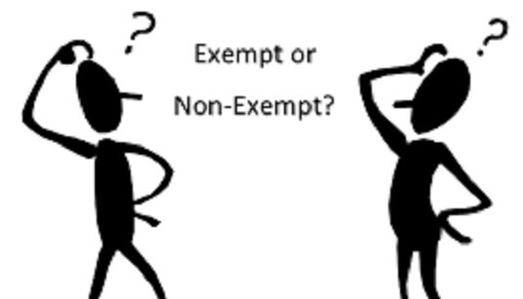
February
February 1st
ALL OWNERSHIP ENTITIES SEEKING EXEMPTION MUST FILE AN INITIAL APPLICATION WITH THE COUNTY ASSESSOR BY FEBRUARY 1 OF THE ASSESSMENT YEAR IN WHICH THE EXEMPTION IS FIRST SOUGHT.
SOME EXEMPT PROPERTIES, OWNERS OR AUTHORIZED REPRESENTATIVES MUST REAPPLY FOR EXEMPTION EVERY THREE YEARS. 2025, 2028, 2031, ETC…
Don’t wait until February to send the re-applications. Exempt applications may be sent and received by staff, but Only the County Assessor may approve applications for exemption, not city assessors. The County Assessor must sign all applications that are approved for exemption. Recommend sending these in November or December of the prior assessment year.
(MINNESOTA STATUTES 272.025, SUBD. 3)
Notes:
MNDOR WILL SEND A MEMO REMINDING ASSESSORS OF THE REQUIREMENT EVERY 3 YEARS.

Slide 16
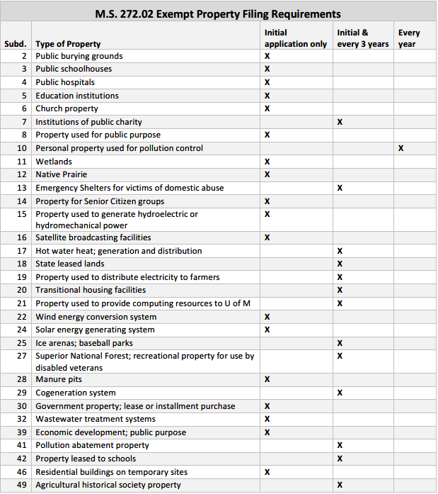
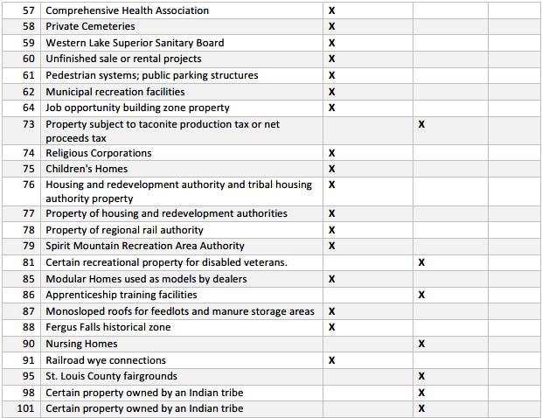
M.S. 272.02 EXEMPT PROPERTY FILING REQUIREMENTS
(MNDOR PT MANUAL, MODULE 5, PAGES 9 & 10)

Slide 17

february
February 1st
At least one voting member of every board of appeal and equalization must have taken training within four years. Training must be completed by February 1 of the year in which the board member will hear appeals.
By this date, jurisdictions have at least one trained member. Recommended at least two just in case one is unavailable.
Open book meetings are not required to have a trained member
Failure to comply
Any city or town that fails to meet the compliance requirements by February 1st of each year is deemed to transfer its powers to the County Board of Appeal and Equalization for a minimum of two assessment years beginning with the current assessment year.
(board of appeal and equalization handbook page 4) (Minnesota Statutes 274.014 & 274.135)
Notes:
County may want to post on county website with trained members link and training link.
IF a local jurisdiction asks if they have to have a bae, they do not have to. They may choose to go with open book.

Slide 18
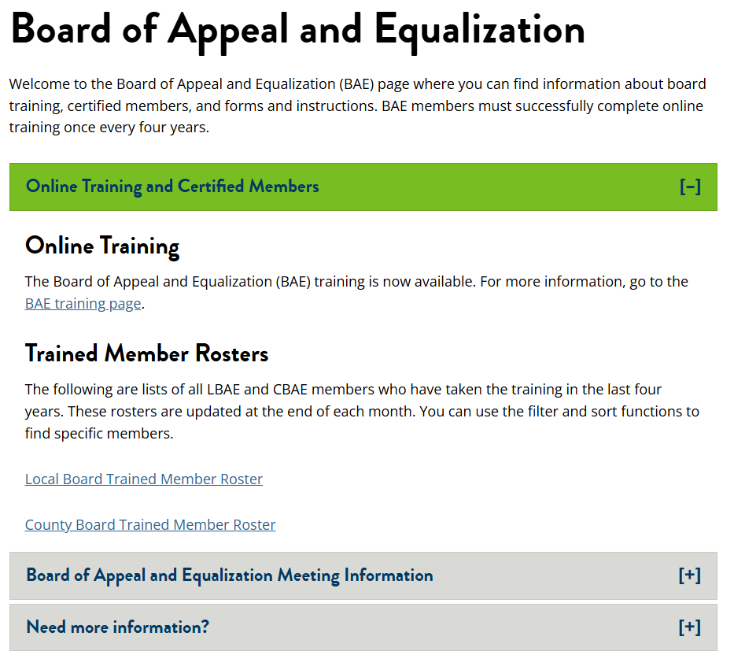
RUN FINAL CHECK FOR ONLINE TRAINED MEMBERS (LBAE & CBAE)

Slide 19
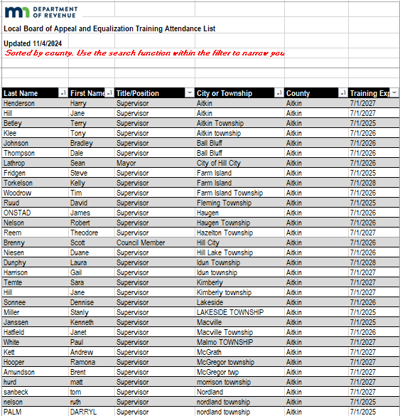
RUN FINAL CHECK FOR ONLINE TRAINED MEMBERS (LBAE & CBAE)
Notes:
Listings are updated periodically. More often towards February 1 of each year.

Slide 20
february
February 1st
Last day for local assessors to deliver assessment records to the county assessor. (Minnesota statute 273.064)
The county assessor may examine appraisal records for local assessors as of December 1 (Minnesota statute 273.065)
Communication with local assessors is crucial!

Slide 21
february
February 15th
Final bae dates due to boards (mn statute 274.01, SUBD. 01)
The assessor shall give written notice of the time to the city or town clerk. Mail and email preferred method.
The clerk of each jurisdiction holding an Lbae shall give published and posted notice of the meeting at least ten days before the date of the meeting. Open book meetings are not required.
Updated valuation notice information within tax system for all bae meetings.
In February, County assessors receive an email from the mndor with instructions to fill out a spreadsheet with lbae/open book dates by jurisdiction. Complete the spreadsheet and email back to proptax.bae@state.mn.us

Slide 22
february
prep/run final abstract (needs to be prepared prior to a/t running final tax) (Example: 2024 assessment, taxes payable in 2025; run End of year 2024 abstract for for taxes payable in 2025 at this time)
a/t office will utilize the final abstracts. Ensure tax capacity has been ran.
any changes made after this date must be communicated with the a/t office. Will affect final tax allocation.

Slide 23
february
RUN prism edits for current assessment. (Previous assessment year final should be complete by this point)
Know what prism is looking for:
Valid state and assessment coding
Valid agricultural class (2a/2b)
Valid hga
Accurate homestead entry
Keep up to date prior to prism submission with:
Splits/combinations
Homesteads
Etc.

Slide 24
february
Looking forward
In the case of manufactured homes assessed as personal property, the homestead must be established, and a homestead classification requested, by May 29th of the assessment year.
Verify solid waste before spring notices go to printer (add/remove)
New homes
Razed/demolished
Etc.
Roll cama over into tax maintenance. This may differ for each county
Values and classification
After cama has been rolled, verify veteran with disability, plat exclusions, and other special applications have carried over correctly. (good practice to spot check data rolled over)

Slide 25
March
Valuation notice file due to outsourcer. If outsourcer is not utilized, file preparation shall near completion for current year assessment.
Valuation notices must be mailed at least 10 calendar days before the lbae or “open book” meetings.
Lbae meetings must be held between April 1 and may 31 of each year.
once valuation notices are mailed, release notices to county website
Look for lbae publishing notices in the newspapers to make sure jurisdictions are publishing by the 10 day deadline.
Notes:
Recommend to post all meetings on county website

Slide 26
March
Prepare local board of appeal (lbae) information:
Informational packets
Sales
Bae instructions
Township averages
2a/2b averages
Maps – utilize gis for ease
According to the Mndor bae handbook, either the local or county assessor is required to have maps and tables relating particularly to agricultural land values for the guidance of the lbae.
Sales
Acres averages (tillable versus deeded acre values?)

Slide 27
March
Looking forward
Send application and reminder to Class 4c(3)(i) and 4c(3)(ii) qualifying non-profit community service organizations (due may 1st)(mn statute 273.13, subd. 25)
Example: legions, vfw’s & etc.
Start prism #1 (due april 1st)
Ensure tax vendor has all legislative updates in to your tax system prior to submission. Don’t wait until last minute to start working on this. Start cleaning up information months prior to due date.
Highly suggested to hold off updating valuations and classifications once prism preparation has started until prism has been accepted by the state.

Slide 28
March
prism #1 & auditor’s prism #3 (due april 1st)
Once you have submitted prism #1 to virtual room within the prism submission room:
Status as completed does not mean accepted or approved by state
The state may have edits for you
These edits will be available in the ptco room if any present.
If you have edits to be made, once they are completed, you must re-submit to the state through virtual room. You must reach out to the prism to have them remove any prior submission for any additional submissions to be accepted.
If you are a new county assessor, you have to ask for permission to access virtual room and any submission rooms. if you change your email, let them know!

Slide 29
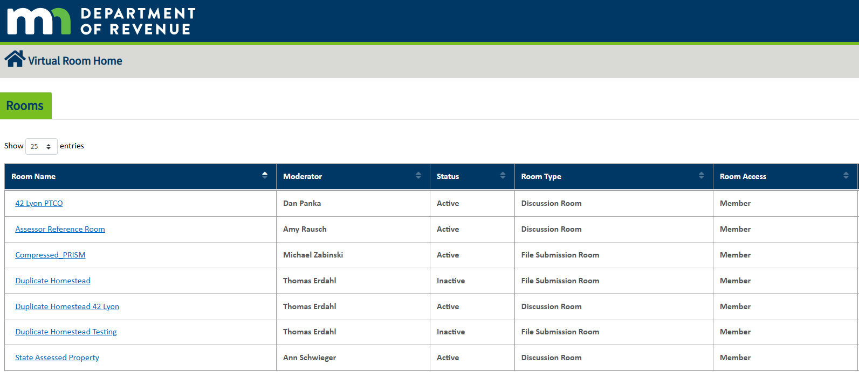

Slide 30
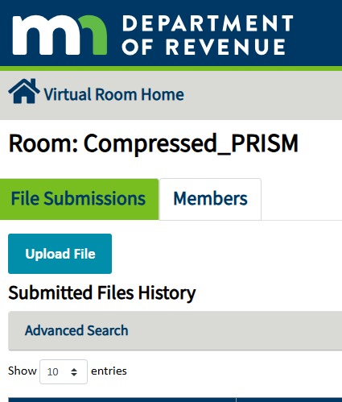

Slide 31
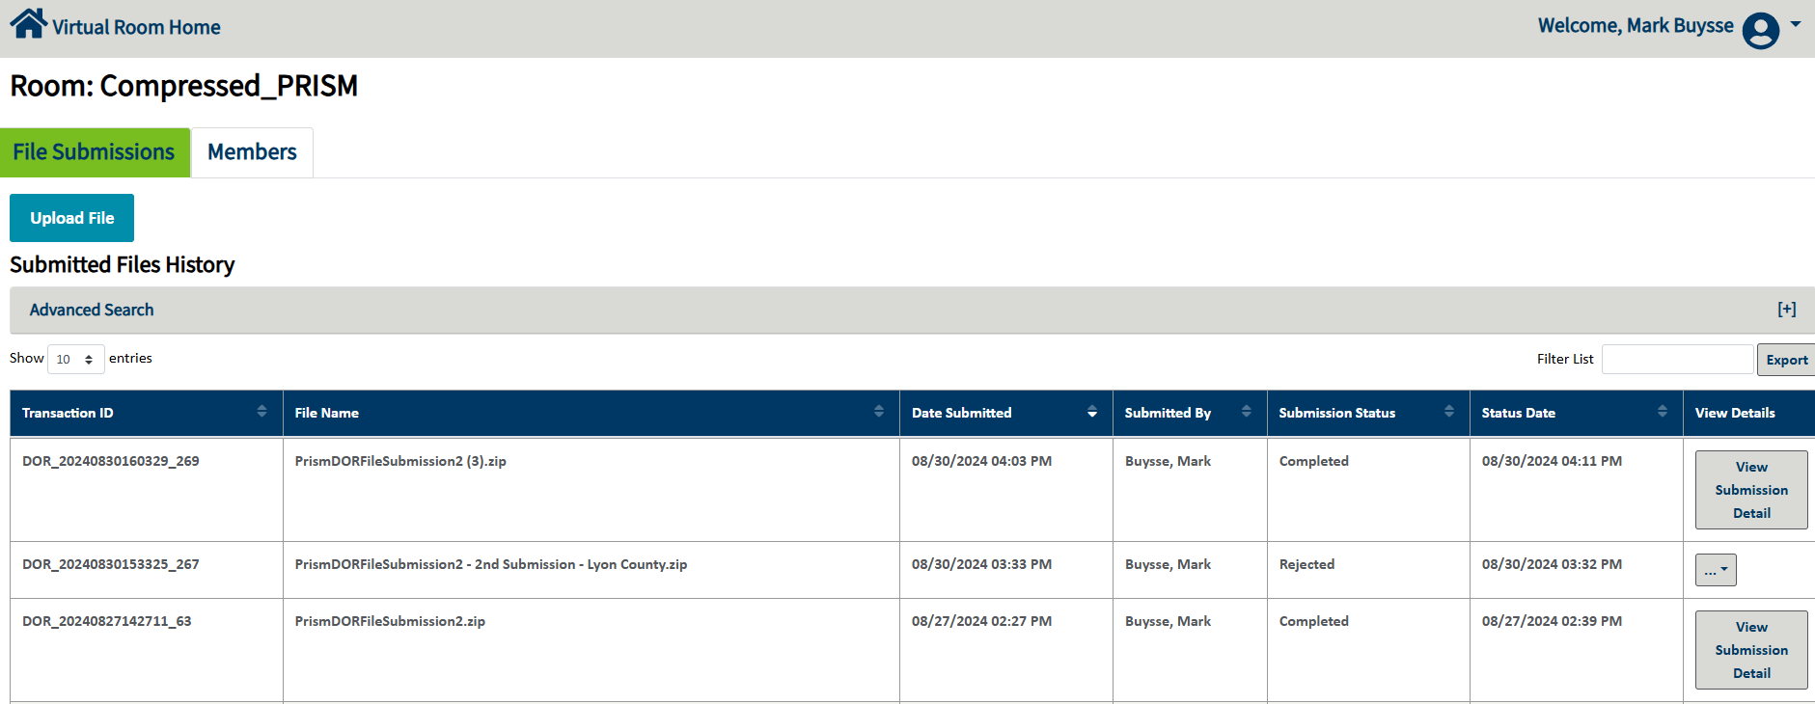

Slide 33
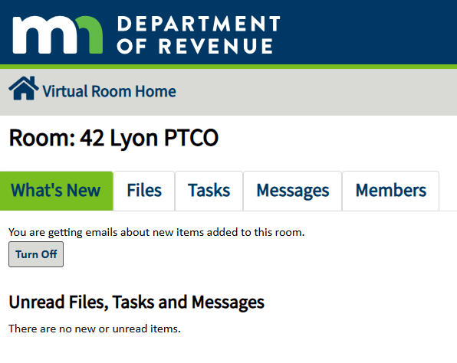
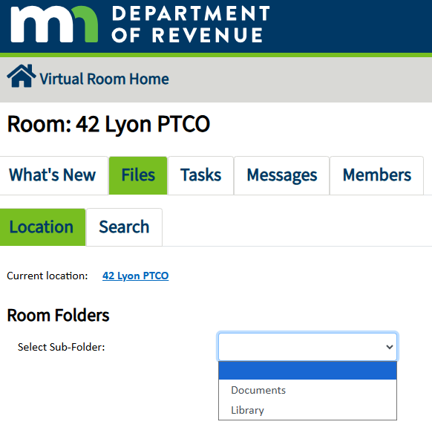

Slide 34
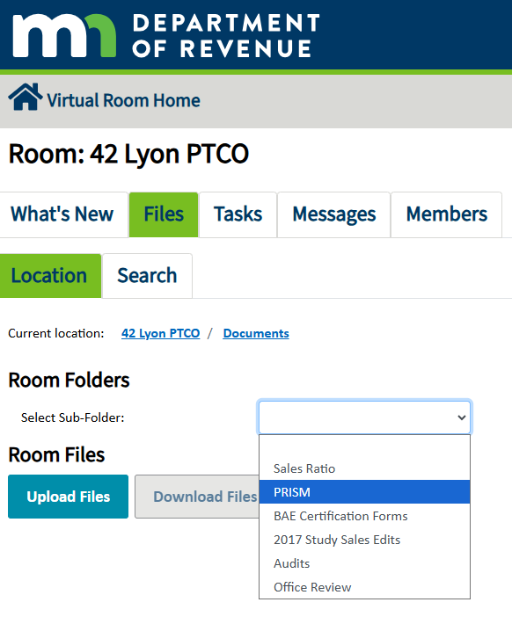

Slide 35
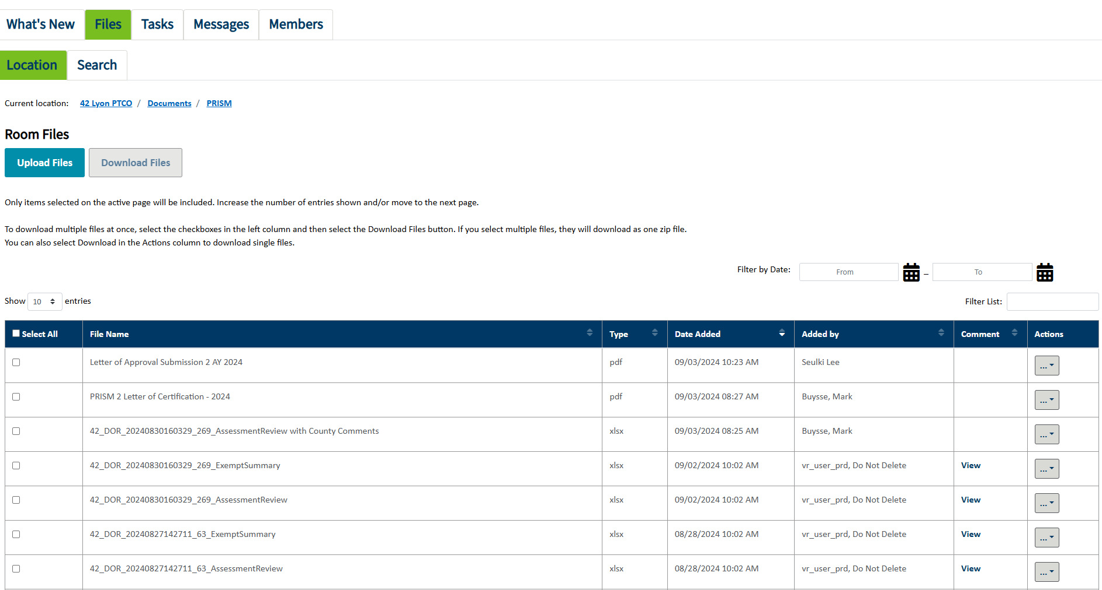

Slide 36
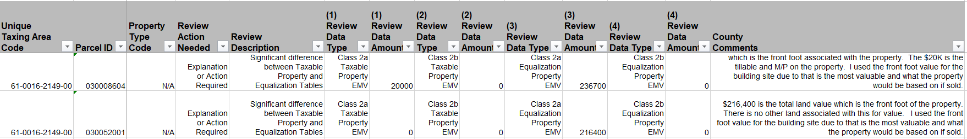

Slide 37
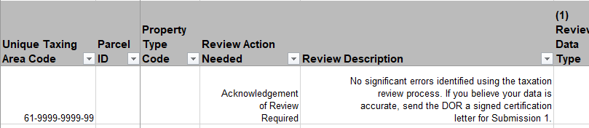

Slide 38

april
April 1st - Prism #1 (spring mini) due
Don’t wait until the last day in march to start preparing prism #1.

Slide 39
april
april 1 – may 31- Local board of appeal and equalization
Submit record forms to dor within 10-days of each bae adjournment
Send letters to taxpayers with bae decisions and next steps to take
Create invoices for assessment services performed for each township/city
may bring to boards or mail. Check your county policy for more details.
True county does not always have billing as it may be figured into the levy.
Scan in all bae documentation for retention purposes
Submit certification forms to ptco after all lbae’s adjourn
If taxpayer contacts county prior to the statutory 10-days prior to the lbae, the assessor may make changes to valuation or classification without bringing them to the lbae with proper notification to the taxpayer. In this instance, send new valuation notice.

Slide 40
TRUE COUNTY
OPTIONAL “TRUE COUNTY” ASSESSOR SYSTEM
ANY COUNTY IN THE STATE OF MINNESOTA MAY ELECT, BY SPECIAL RESOLUTION, TO HAVE ALL TAXABLE PROPERTY IN THE COUNTY ASSESSOR BY THE COUNTY ASSESSOR. This is known as a “true county” assessor system.
No City or township assessors
Property is assessed by county assessor’s Office
County is authorized to appropriate sufficient money to defray the expenses of the assessment
The resolution will be effective at the second assessment date following the adoption
The office of all township and city assessors shall be terminated 90 days before the assessment date at which the election becomes effective
(Pt manual, module 4, page 46)
(Primary Statutory References: 273.052, 273.053, 273.055, 273.056)

Slide 41
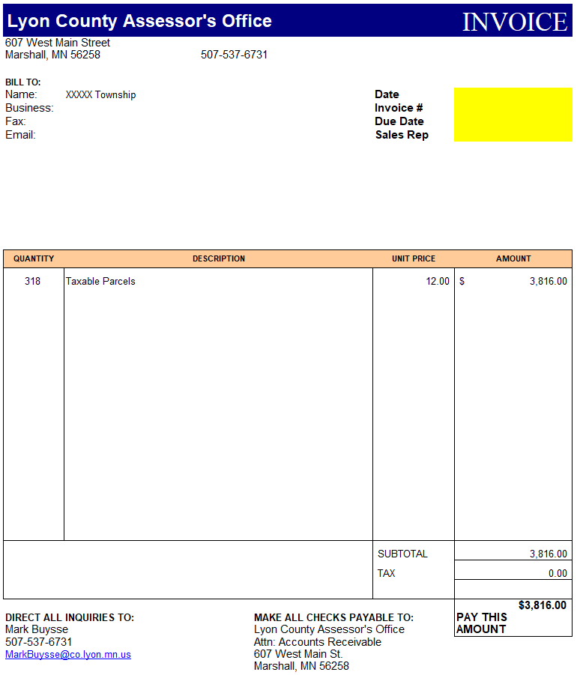
INVOICE EXAMPLE

Slide 42

april
april 1 – may 31- Local board of appeal and equalization
The local board of appeal and equalization handbook state that “the clerk shall publish and post notice of the meeting at least 10 days before the date of the meeting”.
What if the clerk did not post and/or publish notice of the lbae in time (does not apply to open book)
The lbae would need to meet on the scheduled date, announce the situation, publicly set a new date and time and then recess the meeting.
keep the ten day post/publish law in mind.
IF the new date is 21 or more days after the initial meeting date, an extension must be requested since statute requires adjournment within 20 calendar days of the initial meeting.
Notes:
May be good practice for assessor to publish all meetings on their county website

Slide 43


april
board of appeal and equalization
How do counties proceed if they cant get to the meetings?
They should make a public announcement of cancellation as soon as they know it will have to be postponed. The announcement should include a reschedule date if possible. If a quorum of the board can get there, they can convene the meeting and then recess to a later date. They do not need to send new notices but will need to make public announcements (Newspaper/radio) of the new date and time. They should also post the new date and time on the meeting location ASAP, preferably have it posted prior to the original meeting time, so that anyone who does show up will know what is going on.
(mndor property tax administrator’s manual, module 8, page 55)

Slide 44
april
board of appeal and equalization
How do counties proceed if they cant get to the meetings?
Board would not need to wait 10 days, but shall be within the 20-day requirement
notices would not need to be resent
Clerk would not need to republish/repost.
However, they should make every effort to communicate this with the city/town
The CBAE should accept appeals from anyone from a district where a meeting was rescheduled due to weather even if they did not make it to the rescheduled LBAE.
County assessor should notify cbae about this exception

Slide 45
april
board of appeal and equalization
Remember Quorum requirements (quorum is 1 more than 50%)
Open book meeting – held by county assessor office. May appeal between April 1- may 31
Lbae vs. cbae
A property owner or representative must appeal to the local board to be able to appeal to the county board.
lbae
Reduce/increase value
Add improvements
Change classification
Add property to asmt list
cbae
Reduce/increase value
Add improvements
Change classification
Order % inc./dec. for entire class
(1% or less to be valid change)
(board of appeal and equalization handbook page 4) (Minnesota Statutes 274.014 & 274.135)

Slide 46

april
April 30th – last day for tax court filing
Must file in the tax year payable, not the year of the assessment
Small claims division and regular division
https://mn.gov/tax-court/
Taxpayers can appeal to tax court without attending lbae or cbae
Does your county accept electronic filings?
May want to check with your county attorney

Slide 47
april
April 30th – last day for tax court filing
One copy of petition must be served on the County auditor, one copy on the county attorney, one copy on the county treasurer, and three copies on the county assessor. (mn statute 278.01, subd. 1(a))
Why three copies?
County assessor
School district
Jurisdiction and etc.
No “gotchas”
Even though statute does say the assessor must be served with 3 copies, mn tax court has ruled that filing with the auditor is sufficient.

Slide 48
april
April 30th – ptr file due. (part of auditor/treasurer submission #3)
Just for real estate records (manufactured home file is due later in july). This is run for the current payable year, not the current assessment year
example: running april 2025, use 2025 payable. This is submitted through virtual room

Slide 49
may
May 1st
Class 4c(3)(ii) qualifying non-profit community service organizations application due
VFW’s, Legions & etc.
Last day to file for green acres or rural preserve for the current assessment year
Last day for assessor to report value of manufactured homes to the auditor
Last day to file application for 2c managed forest land for the current assessment year
May 15th
First-half real property taxes due (except for class 1c or 4c seasonal commercial and some class 3a commercial property which has until may 31st) (mn statute 279.01)

Slide 50
may
May 29th
Last day to accept homestead applications for manufactured home property (mn statute 273.124, subd. 9)
must have title showing ownership to approve homestead application. A certificate of title is required for a manufactured home (Minnesota statute 168a.02)

Slide 51
may
Looking forward
Send letter to tax court petitioner and schools/districts affected
The county assessor shall immediately forward one copy of the petition to the appropriate governmental authority in a home rule charter or statutory city or town in which the property is located if that city or town employs its own certified assessor. On or before the first day of July, the county auditor must send a list of petitioned properties to the school board of the school district in which the property is located. The list must include the name of the petitioner, the identification number of the property, and the estimated market value of the property. (Minnesota statute 278.01, subd. b)
Review assessor manual/quintile and update if necessary

Slide 52
may
Looking forward
Send relative homestead verification letters. Recommend Annual application.
Some counties may prefer sending these earlier in the year. (Not statutory)
Some counties utilize their own applications while others utilize the mndor application

Slide 53
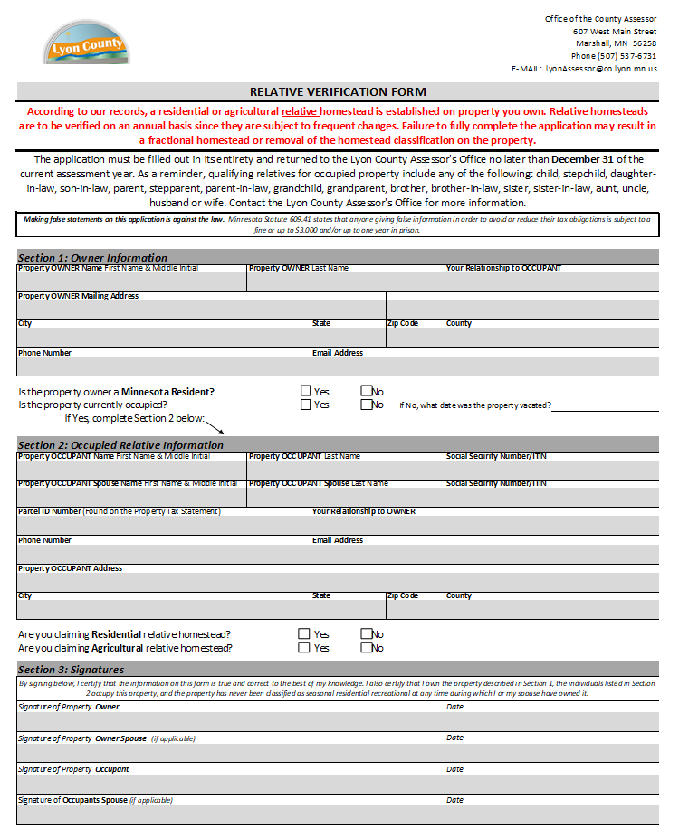
The MNDOR strongly recommends verifying relative homesteads on an annual basis since they are subject to frequent changes.
Owners are to notify the assessor within 30 days of any change in occupancy.
Seasonal Residential Recreational classified property is unable to receive relative homestead.

Slide 54
June
June 1st -
Utility and pipeline and railroad changes to state assessed due
(state assessed requested due date)
June –
Work on preliminary budgets for next year
County board of appeal and equalization (CBAE)
The board may meet on any ten consecutive meetings days in june after the second Friday in june

Slide 56
June
COUNTY BOARD OF APPEAL
AT LEAST ONE MEETING MUST NOT END PRIOR TO 7:00 PM.
THIS IS TO ENSURE PROPERTY OWNERS HAVE AMPLE TIME TO PRESENT THEIR APPEALS.
CBAE MAY MEET ON SATURDAYS.
IF the county does not hold a meeting until 7:00 p.m., they must instead hold a meeting on a Saturday.
The dates of the meetings must be contained in valuation notices.
county board follow up
Submit cbae record form to mndor within 5 working days after county board adjourns
Check to be sure any appeals that resulted in changes are done in the tax and cama system

Slide 57
June
Begin cross county process (agricultural only)
Run reports and send to counties with homesteads extended across borders
Update cross county throughout the year. Best practice to update affected counties as specific situations arise. Re-run and send updated reported before the end of the year to these counties. By December 31st is a good rule of thumb.
Low income rental housing letter will come from mn housing finance agency. Verify the list of parcels (and percentage) match the parcels in your records. (Minnesota statute 273.128)
Contact: steve.oBRien@state.mn.us | (651)297-4065 or (651)296-7608
a/t cutoff for prior year assessment, taxes payable current year
a/t will close prior year soon. Once prior is closed, new year may be opened.

Slide 58
June
Looking forward
Begin assembling special agricultural applications and send out
Be aware of legislative updates affecting these forms. Legislative sessions end the first Monday following the third Saturday in may each year. Special ag homesteads are due December 31st of each assessment year.
Begin proofing prism #2 (best practice to do this multiple times throughout the year)
Multiple parcel listings
Fractional homesteads
Regular and relative homesteads
Special applications
Disabled veterans
Class 1b (blind/disabled)
Continue completing splits/combination

Slide 59
july
July 1st
Cut-off date for changes in taxable/exempt status to be effective for the current assessment year (mn statute 272.02, subd. 38)

Slide 60
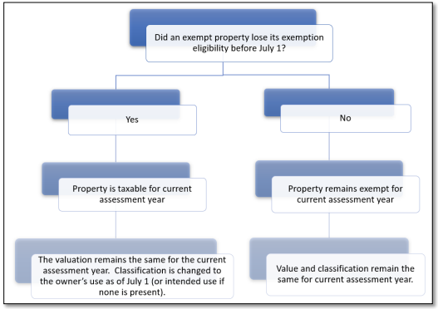
Conversion of exempt to taxable property flowchart

Slide 61
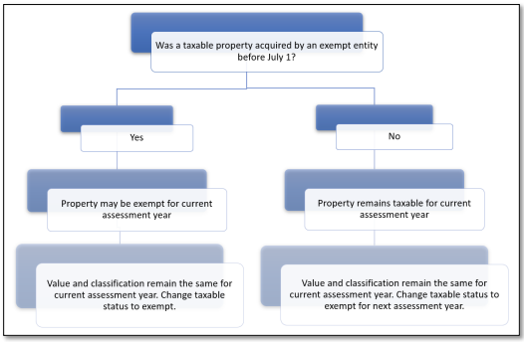
Conversion of taxable to exempt property flowchart

Slide 62
July
July 1st
Veteran service officer (vso) must report a veterans' permanent address and disability rating to the assessor (mn statute 273.13, subd. 34(m))
Send veterans services officer disabled veterans listing with:
name
physical homesteaded address
Current Disability rating
Disabled veteran special homestead stays with the veteran.
Example: if a veteran and their spouse move to another county, the special homestead moves with them. Note: they must apply in the new county to continue receiving the homestead. Prior county special homestead shall be removed, and changed to regular homestead for current assessment.

Slide 63
July
July 1st
Last day property owners can notify the county assessor of entity-owned property that may qualify for linkage to their individually-owned and homestead agricultural property to receive the lower first tier ag homestead classification rate for the current assessment year. (Notification of Agricultural homestead value tier linkage(CR-link))

Slide 64
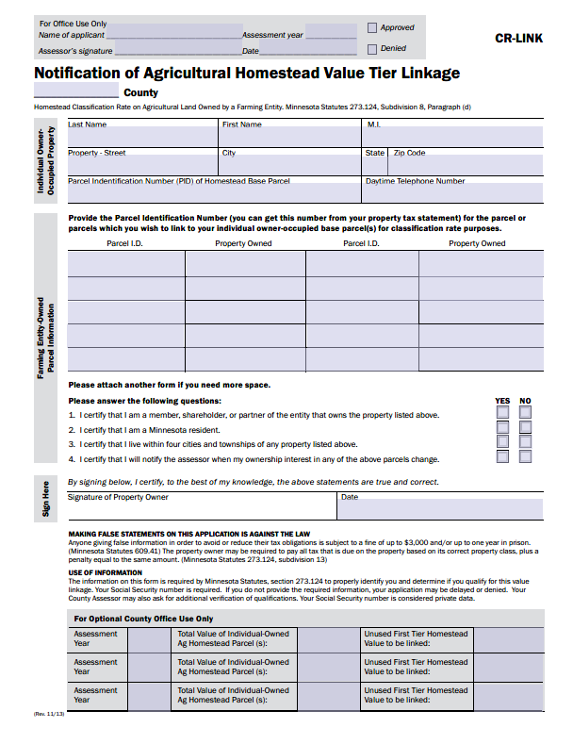
July

Slide 65
July
July 31st
Duplicate homestead file due
It is used to determine eligibility for the property tax refund (PTR) and is compared to information provided by taxpayers on the PTR forms. The PTR data file must include all homestead parcels located in the county.
Run edit listings to ensure there are no false homesteads in your county
Ensure no duplicate socials are reporting in your county. If there are duplicates, review prior to submission to the state. May want to run this multiple times a year to identify differences.
File shall be submitted through the virtual room.
Manufactured home property tax refund (ptr) file is due.
This is run for asmt/payable year the same (ex. Running july 2024, use 2024 payable year)

Slide 66
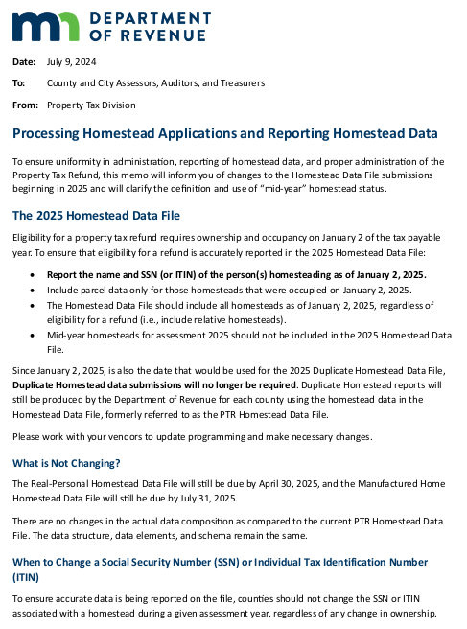
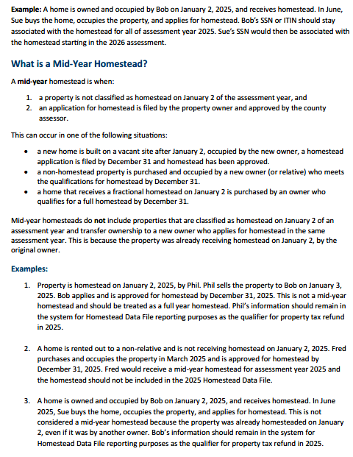
Notes:
Run Social Security Edit listings throughout the year. Don’t wait until you are ready to submit the Homestead Data File.

Slide 67
July
July –
Check personal property records/parcels. Make sure if they are in a rural service district, there are no improvements that exist.
Rural service districts are to include only un-platted lands that are rural in character and not developed for commercial, industrial or urban use (Minnesota statute 272.67, subd. 2)
Enter state board changes into tax (if applicable)
ptco will typically be asking for electronic report of dates viewed for all properties to verify quintile compliance.
May 15 April 1st is the default compliance date. Parcels viewed within 5 years of this date are considered within compliance. (Not statutory)

Slide 68
July
Looking forward
A paper copy of the Mndor state assessed utility, pipeline and railroads values will be mailed to counties along with an email notification starting in july.
Once received, Enter Utility, Pipeline and railroad market values into tax.
Equalized Railroad values must be sent by June 30th of each assessment year
Equalized Utility and pipeline values must be sent by july 15th of each assessment year
Administrative appeal determinations and settlements must be completed by august 31st for railroad and by October 1st for utility and pipeline
Mndor state assessed may correct errors that are clerical in nature until December 31st
A copy of the state assessed equalized and final values are posted in excel format on the mndor website and within the mndor e-services page. Your auditor/treasurer’s office should have access. Some assessor’s offices have access in addition. Mostly on a limited basis. Ask your county for more details

Slide 69
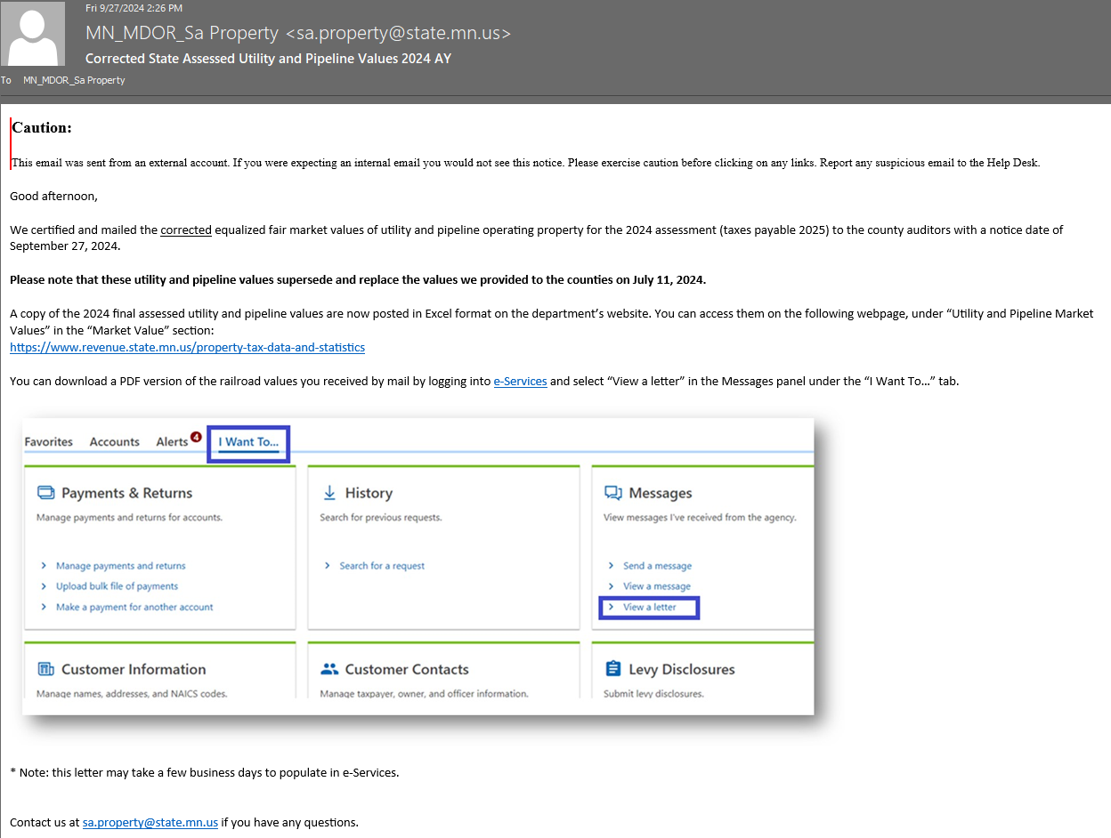

Slide 70
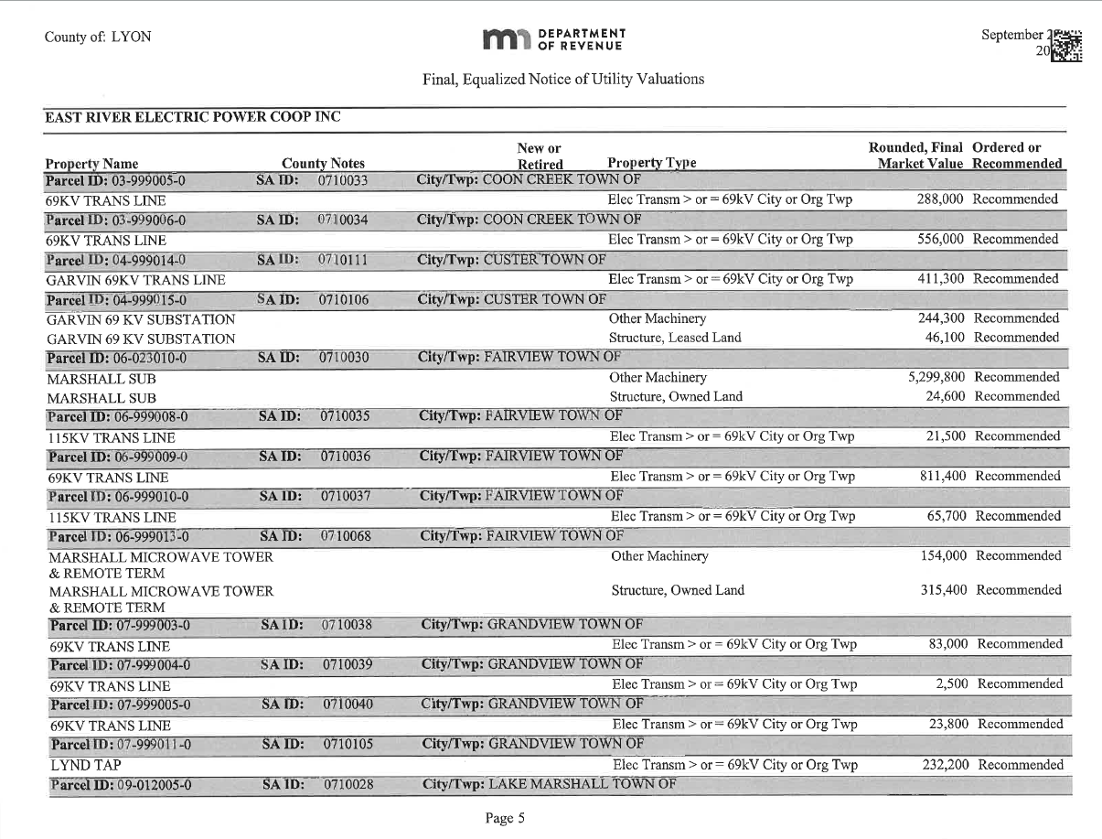

Slide 71
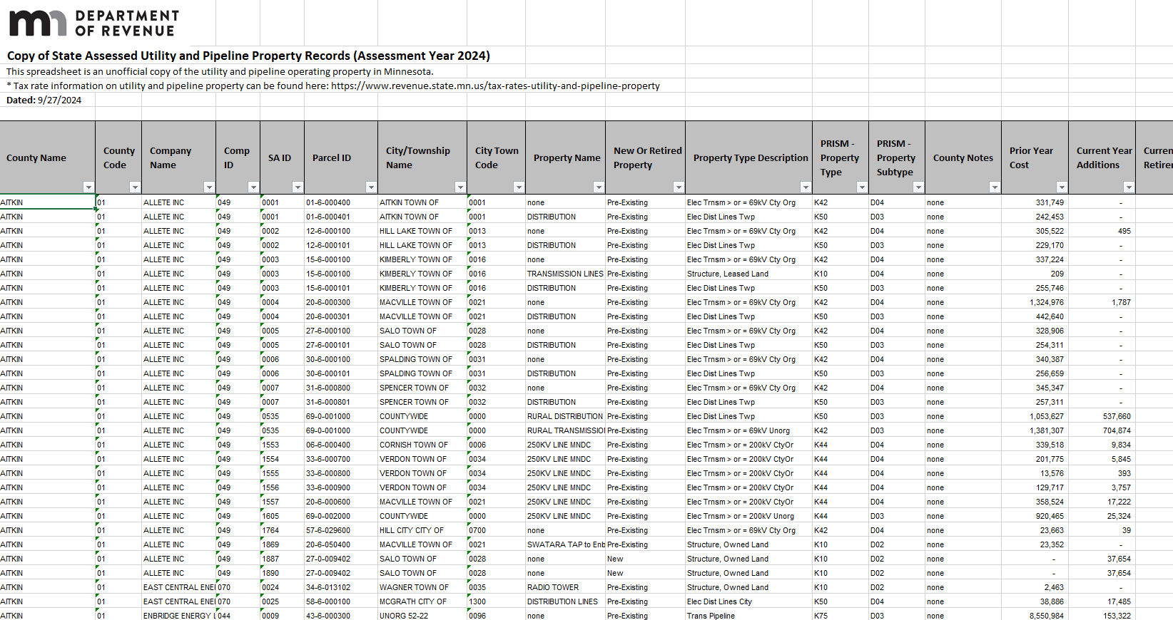

Slide 72
august
Prepare prism #2 submission (don’t wait until September 1st)
Run prism edits
Complete all splits/combinations
Approve/deny all homesteads in possession up to this point
Regular, relative and special homestead
State assessed – railroad, utility & pipeline
Mp linkups
Ownership maintenance – taxpayer name change listings
Etc.
Email cross county information to other counties
Keep Cross county information up to date
Run 2a/2b report

Slide 73
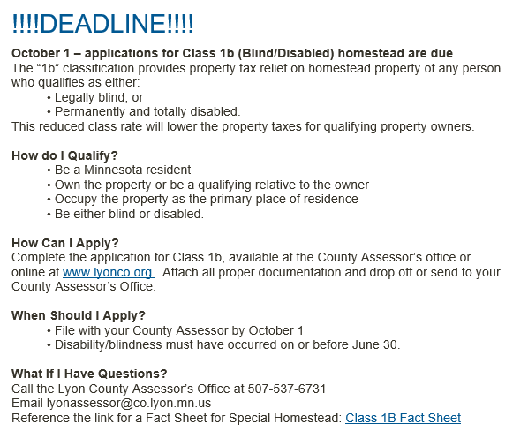
august
Post message on social media and website about class 1b (blind/disabled) deadline approaching. (October 1st) (Minnesota statute 273.1315)
Example:

Slide 74

august
County assessor must take oath of office once every 4 years upon reappointment ( 2025, 2029, 2033, 2037…)
Email will be received from mndor with reminder
must be confirmed by the county board and commissioner of revenue
Must apply for and pass a background check (mndor paid)
They review for income taxes paid, felony and etc. if no action is taken by October 1, then the county board confirmation is approved but not by the commissioner of revenue.

Slide 75
august
August 31st
Last day to pay first half of personal property tax on manufactured homes

Slide 76
september
September 1st - Prism #2 & auditor’s prism #4 submission due
September 30th – sales ratio study concludes
The deadline for submitting all eCRV’s from the 12 month study, October 1 thru September 30, that were accepted by the county before today November 1 must be submitted to the state by the 5 pm November 10. no exceptions if the day is over the weekend.
Early appeal deadline for time trends is November 18th
Last day to make ecrv edits is beginning of December (around the 1st) (exact dates to be determined)
Final time trend appeal deadline is mid December (exact dates to be determined)
Final preliminary reports will be sent to all counties January 21st by your mndor ptco. The report will only have the 12-month sales study.

Slide 77
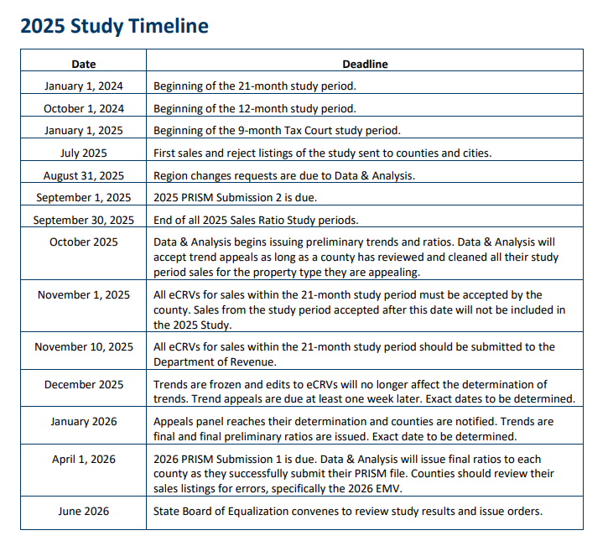
september
Timeline located within the 2025 sales criteria manual.
Each year sale criteria manual is updated. Reference for changes.
Ptco will give you final dates that are subject to change yearly.

Slide 78
september
LOOKING FORWARD
Make sure valuation notice forms are ordered and/or coordinated with the outsource vendor for printing.
VALUATION NOTICES MAILED IN MARCH/APRIL

Slide 79
october
October 1st
class 1b (blind/disabled) homestead applications due. Must be certified by june 30th of the application year.
“notice of award” letter from social security administration stating “you are entitled to monthly disability benefits beginning xxxxxx, xx 20xx”
Class 1b special homestead stays with the blind/disabled person.
Example: if a blind/disabled person and their spouse move to another county, the special homestead moves with them. Note: they must apply in the new county to continue receiving the homestead. Prior county special homestead shall be removed, and changed to regular homestead for current assessment.
october 1st –
last day to file in tax court regarding manufactured home valuation or taxes

Slide 80

october
Looking forward
START PREPARING NEW CONSTRUCTION
REACH OUT TO LOCAL JURISDICTIONS FOR PERMITS
Rechecks from previous year
Utilize spreadsheets or lists
MAPPING
May want to utilize gis
Checklists on maps may help
With larger jurisdictions.

Slide 81
october
Early October - Cutoff for tnt’s (proposed tax statements)
Assessor/auditor/treasurer shall run prelim tax capacity for proposed tax statements. During this time, county’s are limited or cutoff from making changes within the tax system for the current assessment, taxes payable the following year.
Good practice to have file, folder or application to document changes that need to be made during the down time
What to do prior to tnt:
Run tax capacity and system edits – prism edits
run abstracts
Finalize splits/combinations
approve/deny and enter ALL APPLICATIONS and information into tax:
Exempt REGULAR AND RELATIVE homesteads
Class 1b special homesteads
Disabled veteran state assessed – railroad, utility and pipeline
Finalize asmt codes, values, mp’s, choice codes
Maintain cross-county

Slide 82
october
With sales ratio study concluded, make sure ecrv’s are processed as quickly as possible.
What should you keep in mind while reviewing sales listings from the mndor?
Review “extreme” flagged sales – ensure they are good arm’s length sales
Split indicator
Land/building indicator
If there is an “x” here, most likely an issue needs to be resolved
Large financing adjustments
Check all contract for deed terms and conditions are correct as entered
Land building indicator
If land only, make sure no building value present
Small building value may be present with agricultural land sales. Will want to be indicated as land only. Includes non-ancillary structures that are less than 300 square feet
Make sure deeded and tillable acres match

Slide 83
october
What should you keep in mind while reviewing sales listings from the mndor?
Double check pt aggregation is correct (ag is ag, res is res)
The biggest thing to double check is that all information in columns c-m and x-ab is correct. For ag sales you will also want to double check columns ar-as to make sure the information is correct. Lastly, please use columns cf-cj as an aid in making sure any sales that have an “x”, the information is correct.
All edits should be made and final prior to trend appeals. There shouldn’t be any edits to make past the trend appeals.

Slide 84
october
October 15th
Last day for assessor’s to certify approval of applications for open space for current year (due date is November 3rd)
Open space - actively and exclusively devoted to golf, skiing, lawn bowling, croquet, polo, or archery or firearms range recreational use or other recreational uses carried on at the establishment
at least five acres or more in size, except in the case of lawn bowling, croquet greens, or archery or firearms ranges
Last day to pay second half real estate taxes unless part of the parcel is classified 2a agricultural land OR IS PERSONAL PROPERTY (2a AND PERSONAL PROPERY due November 15th) (mn statute 279.01)

Slide 85
october
Looking forward
Check with county board and/or administrator, the assessor reappointment has been confirmed or denied.
Your board must notify the county assessor, no later than October 1, if it does not intend to reappoint the assessor.

Slide 86
october
Looking forward
SOME EXEMPT PROPERTIES, OWNERS OR AUTHORIZED REPRESENTATIVES MUST REAPPLY FOR EXEMPTION EVERY THREE YEARS. 2025, 2028, 2031, ETC…
Don’t wait until February to send the re-applications.

Slide 87
november
November 1st
Declared disaster area applications due to executive council
Submit all information to mndor property tax division by November 1 of the year which the disaster occurs.
November 3rd
Open space applications due 60 days prior to January 2nd (MN Statute 273.112)
November
Once tnt notices have been mailed, start making changes in tax system again
Talk with your auditor/treasurer prior to doing so….
Duplicate social security number report from mndor (typically received end of October)
Verify with other counties any matches of ss#’s that appear on the report
Make appropriate changes to ensure no duplicate homesteads are present

Slide 88
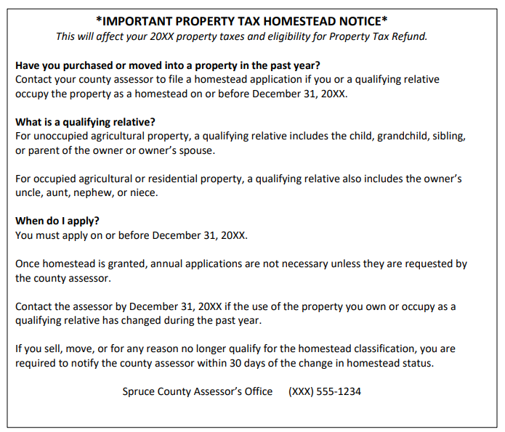
november
Send homestead notice reminder to local paper no later than December 1 of each year (mndor supplies format) (Mn statute 273.124, subd. 9)
Property tax Administrator’s Manual, module 4 - homesteads
ADD NOTICE TO WEBSITE OR SOCIAL MEDIA PLATFORM

Slide 89
november
Start preparing information for valuation
Township average and border reports
Sales information
Mcast
If you plan to appeal your trend, mcast is a very helpful tool
Verify ag homestead link ups
Ensure all parcels in identical ownership are linked up for taxation purposes
Example: run county wide listing with taxpayers names, parcels, homestead linkup parcel, assessment code and etc.
This will help identify homestead application and/or removal and remaining tier for taxation purposes
Good time to send second notices for special ag and regular homesteads if not received

Slide 90
november
November 15th
Last day to pay second half of personal property tax on manufactured homes
Last day to pay second half of 2a agricultural land tax
(mn statute 279.01)

Slide 91
december
December 1st
Homestead notice to local papers due
Assessor shall publish in a newspaper of general circulation within the county no later than December 1 of each year a notice informing the public of the requirement to file an application for homestead by December 31
December 1st
Examine local assessors work after December 1 of each year and advise the local jurisdiction of deficiencies. Follow up is highly suggested if deficiencies are identified. (mn statute 273.064)
Last day for local assessors to deliver assessment records to the county assessor is February 1st. (Minnesota statute 273.065)

Slide 92
december
December 31st
Last day to “own and occupy” and apply for homestead (MN Statute 273.124, subd. 9)
Special ag applications due (MN Statute 273.124, subd. 9)
Veterans application deadline
What if application is made after deadline?
Non-homestead for current assessment
Cut off for splits/combinations for current assessment year
December
Truth in taxation meetings
County assessor’s may be asked to attend these meetings. However, these meetings are about the local levy’s, not value or classification.

Slide 93
december
December
Exempt reapplications sent every three years
Next in December 2027, due before February 1st 2028, for taxes payable in 2029
Review all fire or disaster abatements
Local option disaster abatements and credits
Reference mndor (property tax relief for damaged or destroyed property fact sheet on mndor website)
Changes to exempt/forfeited to state can be made up until December 31st
Cross County Values to Auditor/Treasurer and other counties (not statutory)

Slide 94

Basic timeline complete! Now what?

Slide 95
work on assessment procedures and processes throughout the whole year. Don’t focus just on deadlines see the assessment in its entirety

Slide 96
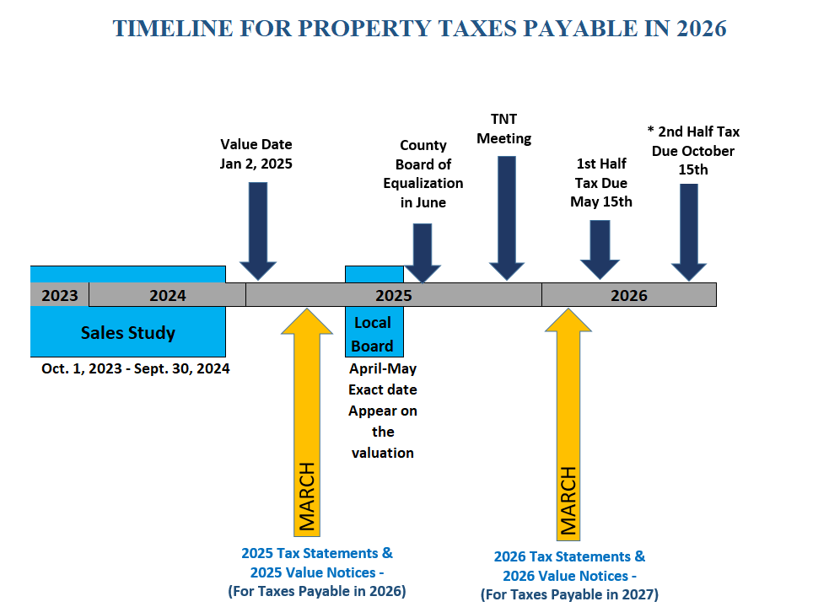

Slide 97
What to work on throughout the year
Sales verification (ecrv’s)
Homesteads
Quintile
Assessment manual
Tax estimates/splits
Additional duties

Slide 98

SALES VERIFICATION (ECRV’S)
An electronic certificate of real estate (eCRv) must be filed when Minnesota real property is sold or transferred for consideration of more than $3,000. The department of revenue and the county of sale, review ecrv information to verify sale terms and to ensure fair property tax assessments.
Have a process or procedure in place with assessment personnel to verify, complete and submit all ecrv’s timely.
Daily, Weekly, bi-monthly, monthly, etc.
This may be different for every office depending on county size and demographic

Slide 99
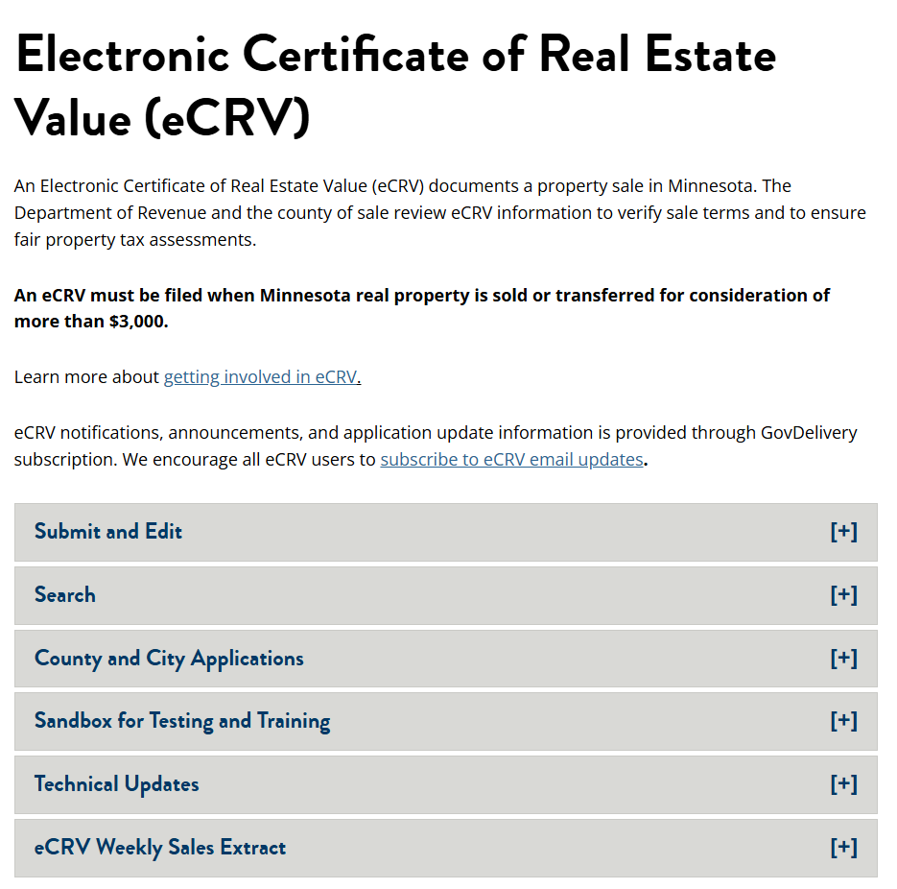

Slide 100
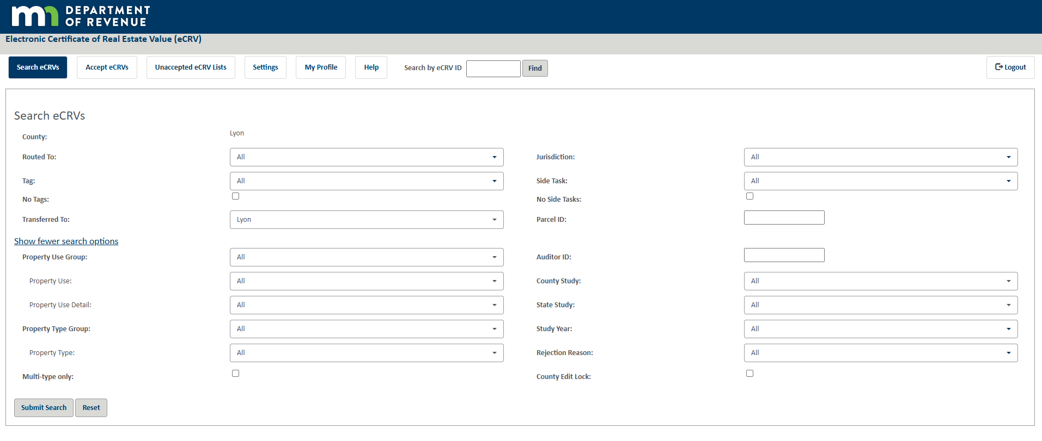

Slide 101

HOMESTEAD
Applications
Send reminders, verify, approve/deny applications
Regular homestead – residential and agricultural
Trust owned – certificate of trust
Mda registered for irrevocable trusts
Entity ownership breakdown
Mda registered?
Address change
Change of ownership
Relative homestead
Special agricultural homestead
Special homestead
Disabled vet
Blind/disabled
Etc.
administer and code

Slide 102
HOMESTEAD
THROUGHOUT THE YEAR, YOU MAY WANT TO SEND OUT SECOND OR THIRD NOTICES FOR HOMESTEAD APPLICATIONS AND SPECIAL AGRICULTURAL HOMESTEADS.
THIS IS NOT A REQUIREMENT, BUT GOOD PRACTICE. (Best practice to document each attempt)

Slide 103
QUINTILE
Quintile plan
Have a quintile reassessment plan
Is this plan accessible to staff and local assessors?
Update annually
Be specific and consistent.
Plan includes all jurisdictions within the county
specify detailed parcel ranges including parcel counts
ASSIGN JURISDICTIONS TO SPECIFIC APPRAISERS/ASSESSORS
HAVE written expectations regarding what the quintile review entails
UPDATE LETTERS/POSTCARDS
SEND LETTERS/POSTCARDS PRIOR TO QUINTILE (NOT REQUIRED)

Slide 104

ASSESSMENT MANUAL
The MNDOR conducts annual REVIEWS WITHIN THE ASSESSOR’S OFFICE evaluating:
PARCEL AND STAFFING INFORMATION
OFFICE ADMINISTRATION/POLICIES
CLASSIFICATION AND VALUATION
STATE BOARD OF EQUALIZATION (SBAE)
QUINTILE COMPLIANCE

Slide 105
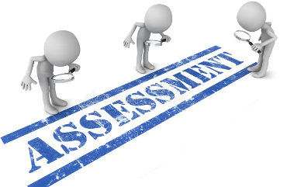
ASSESSMENT MANUAL
Parcel and staffing
How many parcels are assigned per county support staff?
Quintile
ARE ALL PARCELS IN COMPLIANCE? IF NOT, IDENTIFY DEFICIENCIES.
Assessors certify compliance with the mndor yearly
Policies and procedures
Sales chasing, private data, CONFLICT OF INTEREST, split/combination, bae, tax court, NEW CONSTRUCTION, VERIFYING SALES, EXEMPTIONS, ABATEMENTS, LICENSING and etc.
Assessment information
Building schedules
Bae information
EXPECTATIONS (BOTH INTERNAL AND EXTERNAL)

Slide 106
ASSESSMENT MANUAL
Classification and valuation
Is your county free from issues regarding ag, residential, srr, apartments or commercial/industrial?
Applications
Homestead, class 1b, green acres, disabled vet, and etc.
Memos – Now located within the mndor absorb website
STATUTES

Slide 107
Tax/valuation splits
Assessors may be required/requested to perform tax splits. Tax splits take into account preferential class rates, split classification, fractional ownerships, value exclusions, and all other special provisions that impact determination of net tax capacities (ntc).
Utilize tax/cama systems
Understand Minnesota class rates
Understand impact of exclusions and credits applied
When splitting property after boards of appeals are complete, the value and classification may not change during the year of the split except for:
Clerical or hardship
Homestead (ag to res, or res to ag)

Slide 108
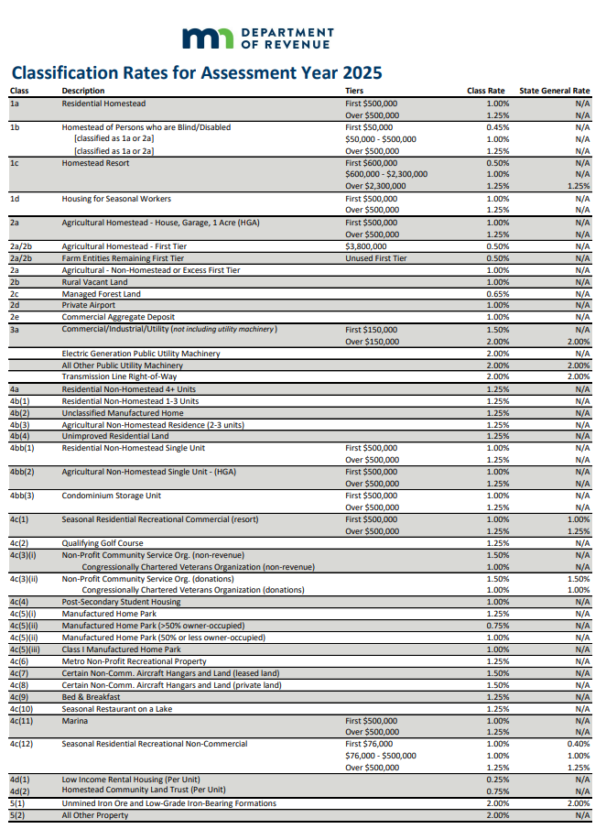

Slide 109
Additional duties
Cama updates
Update cama to tax
Close out old and open up new year valuation
Region changes and meetings
Attend region meetings
Border values, Building schedules, scenarios, committee reports, presentations & etc.
Off topic research relative to assessors
One time coding
State assessed questions/inquiries
Taxpayer inquiries: estate planning, solar/wind, etc.
Be prepared to multi task and be pulled different directions

Slide 110
What if I have questions
Fellow assessors and/or assessment staff
Networking
Conferences
(Summer Seminars and Fall Conference)
Minnesota Association of Assessing Officers (Maao)
Reps
(vanguard, cpt, tyler tech., American solutions and etc.)

Slide 111

Property Tax Compliance Officer (Ptco)
Ptco
Region 1 – mark vagts
Region 2 – sherri Kitchenmaster
Region 3 – Gale Zimmerman
Region 4 – Andrew imes
Region 5 – dan panka
REGION 6 – AMY RAUSCH
REGION 7 – LISA WILL
REGION 8 – BRAD AVERBECK
REGION 9 – GALE ZIMMERMAN/MARK VAGTS

Slide 112
Mndor
Info and education
email: proptax.information@state.mn.us
Letters database
Website: maao.memberclicks.net/mn-dept-of-revenue (Moved to absorb summer of 2025)
Memos (virtual room OR CONTACT PTCO)
PRISM
Email: prism.mdor@state.mn.us Phone: (651)556-3097
Property tax administrator manual Website:
Website: https://www.revenue.state.mn.us/property-tax-administrators-manual
Minnesota legislature
website: www.leg.mn.gov/
Minnesota association of assessing officers (maao)
Website: https://www.mnmaao.org/
Minnesota state board of assessors
Licensing and education https://www.mndor.state.mn.us/boalicensing/Account/Login

Slide 113
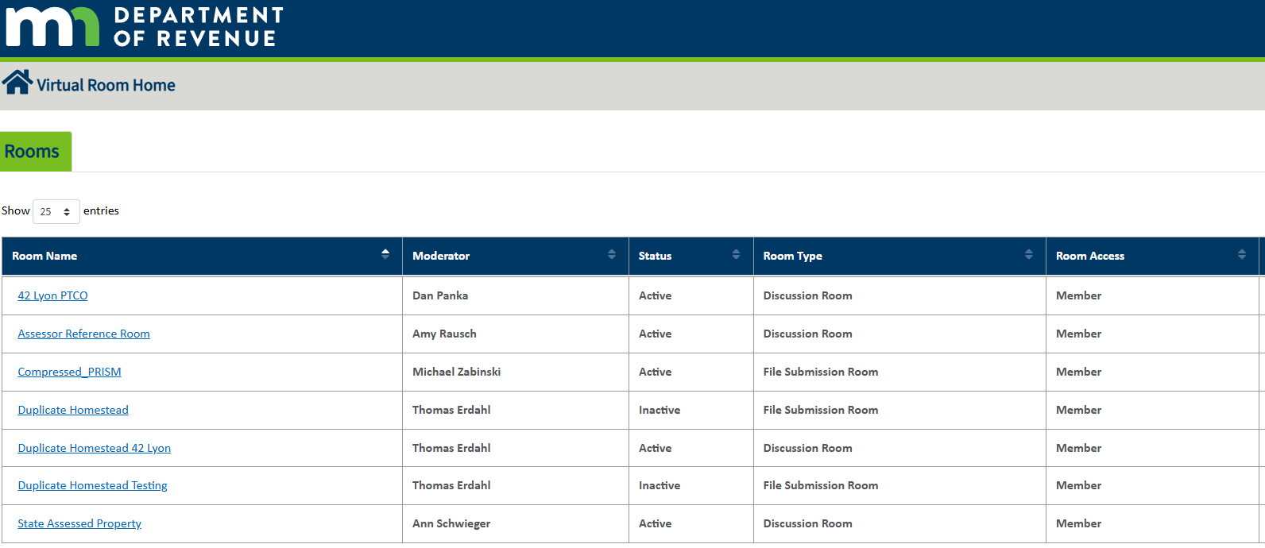
Virtual room – what is it?

Slide 114
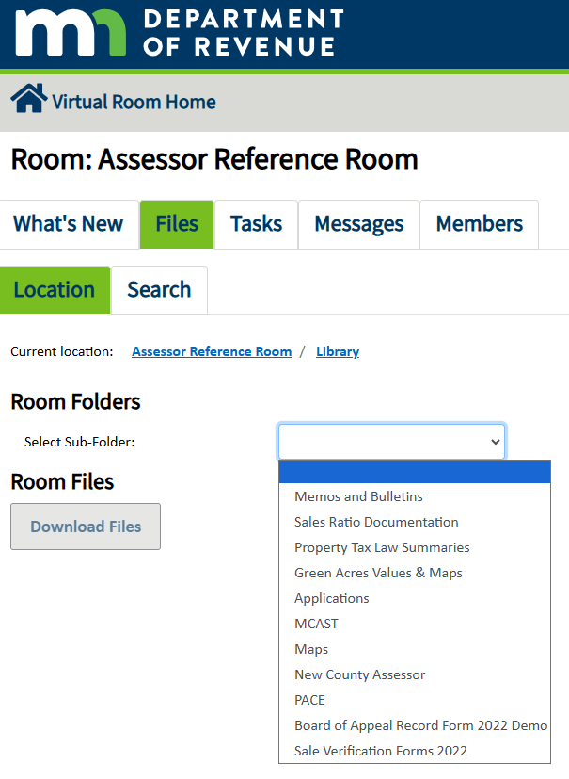
Virtual room – what is it?

Slide 115
What you may not know
Virtual room
Every county assessor shall have access to the virtual room. County’s may also choose other assessment staff to have permissions.
Contact prism to ensure they have you in their system for each of these rooms:
Compressed prism – Submission room
Ptco – discussion room
Assessor reference – discussion room
New county assessor library
Duplicate homestead
State assessed property

Slide 116
What you may not know
Virtual room
Contact prism to ensure they have you in their system for each of these rooms:
Duplicate Homestead – file submission room
State Assessed property – discussion room
If you have questions, contact:
virtual room support | VR_support@state.mn.us | (651) 556-0691

Slide 117


Slide 118
Thank you!!!
Mark Buysse | Lyon county assessor | markbuysse@co.lyon.mn.us
Jean nelson | pipestone county assessor | Jean.Nelson@pcmn.us
Bonnie lay | pope county deputy assessor | bonnie.lay@popecountymn.gov

