Slide 1
MCLEOD COUNTY CROP PRODUCTION INDEX Presentation by Sue Schulz, County Assessor

Slide 2
Where do these CPI soil rating numbers come from?
They are based on the USDA soil surveys done in Minnesota.
•The USDA and the most County Soil Conservation Services conducted this comprehensive survey.
•Each soil type was tested, graded, and mapped out by a team of soil scientists

Slide 3
The University of Minnesota worked with each county to utilize this original soil survey.
Soils were assigned a CER (Crop Equivalency Rating).
These CER Soil ratings were utilized and recorded on CRV’s and supported by the University of Minnesota until about 2009.
The technology has changed, and CPI Soil ratings were found too more accurate.
Notes:
Each 40 acre tract had an assigned CER rating-regardless of whether till or woods.
Anyone remember getting FSA aerial photos and overlaying a little plastic sheet on a parcel and counting the dots to determine the acreage of a field?

Slide 4
Soil Properties
Soil properties are determined by field examination of the soils and by laboratory index testing of some benchmarks.
Shallow borings are made
Identify and classify the soils
Delineate them on the soil maps
Test verify field observations
Based on the USDA soil surveys done in Minnesota
The USDA and the County Soil Conservation Services conducted a comprehensive survey
Each soil type was tested, graded, and mapped out by a team of soil scientists

Slide 5
CER (crop equivalency rating)
Although this type of land valuation is no longer support by the MN extension office it is still used in come counties in the state. It is different from CPI in what it looks at to determine soil capabilities.
Soil properties
climate
Prevalent crop combinations
Market value of crops and cost of production
Rating are the same as CPI (100 – 0)
Specific to MN

Slide 6
CPI (crop productivity index) soil ratings
Based on physical and chemical properties and hazards of flooding or ponding
Water capacity – quantity of water that the soil is capable of storing
Slope
Soil moisture status
Cation-exchange capacity – how well the soil holds nutrients
Organic matter – plant and animal residue in the soil
Salinity
Each different type of soil has a productivity rating assigned to it.
100 highest 0 the lowest.
You will see soil being marketed based on these CPI soil ratings.
Notes:
These productivity ratings are based on each soil type ability to produce a major crop,

Slide 7
What is the differences between the two soil rating systems?
CER Ratings CPI Ratings
Assumes a moderate level of management. Assumes a moderate level of management.
Growing degree days used Growing degree days not used
Average rainfall used Average rainfall not used
Production costs were factored in Production costs not considered
Chemical/physical soil properties not used Chemical/physical soil properties used
Drainage not considered a factor Soil drainage is factored in
Same soil CER will vary by county Same CPI soil type is the same throughout the state
The CPI Soil Rating more accurately reflects the actual productivity of soils and is based largely on each soil type’s actual ability to produce a crop.
Notes:
Corn the mostly widely grown crop in the state formed the basis for these CPI soil ratings.

Slide 8
Places to find CPI Ratings
Web Soil Survey
https://websoilsurvey.nrcs.usda.gov/app/
Acre View
https://www.acrevalue.com/

Slide 9
McLeod’s Transition
From ABC to CPI

Slide 10
How we converted from ABC to CPI soil ratings
GIS mapping capability is required
Each parcel has a GIS overlay with the soil types.
Each soil type is mapped.
These revisions are entered into the valuation schedule and valuation system each county has in place.
Notes:
So far none of the townships converted has seen the aggregate value change by more than 2%-however some individual parcels may move up or down more than that.

Slide 11
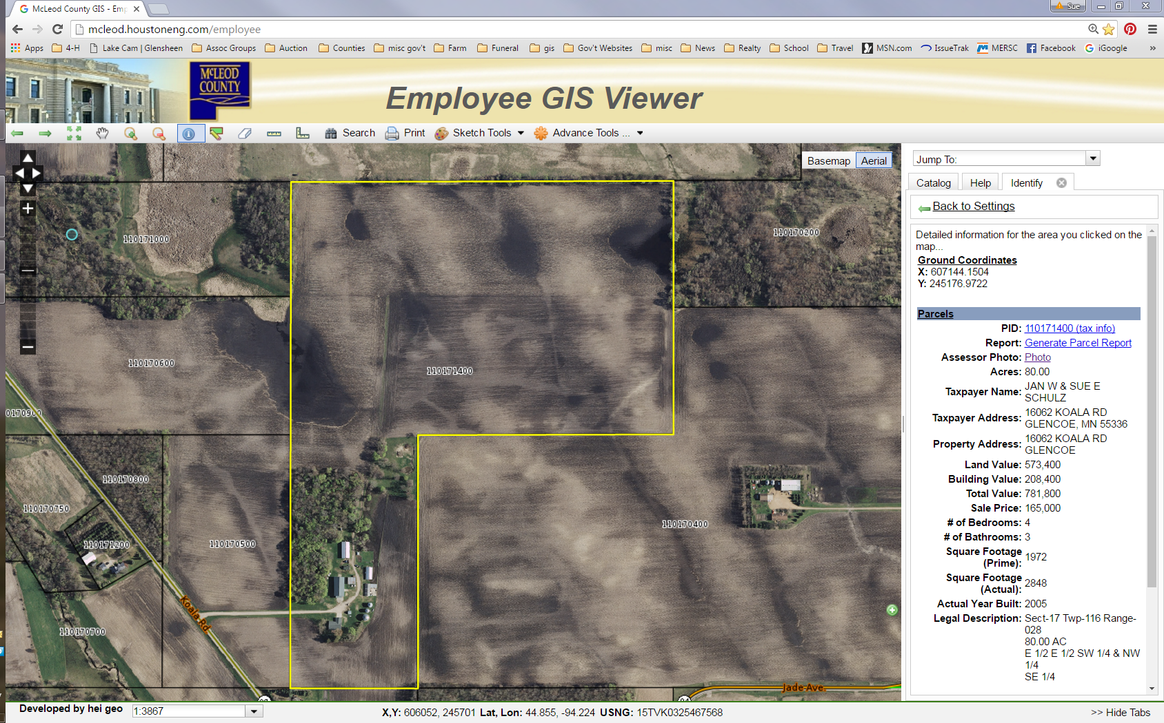

Slide 12
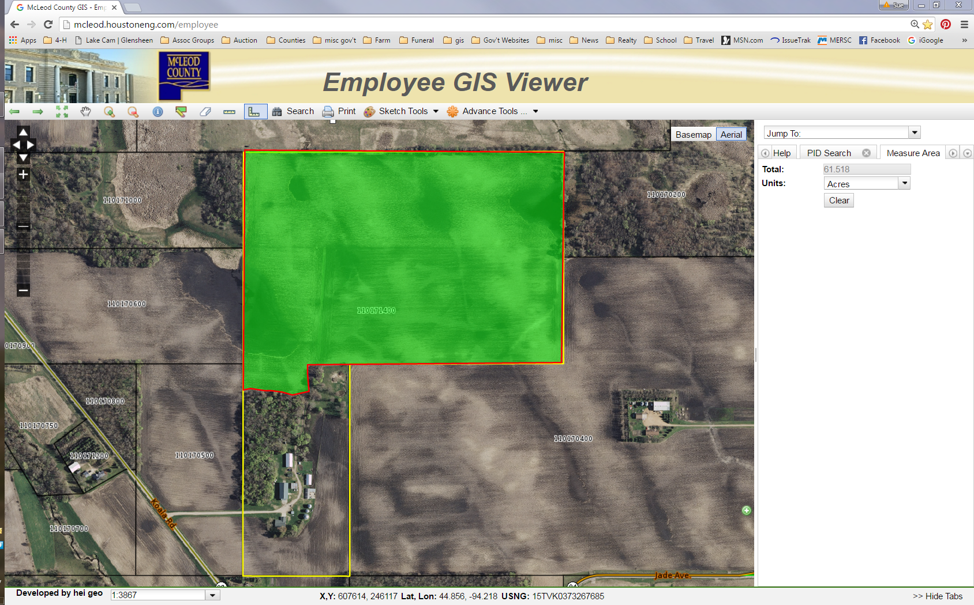

Slide 13
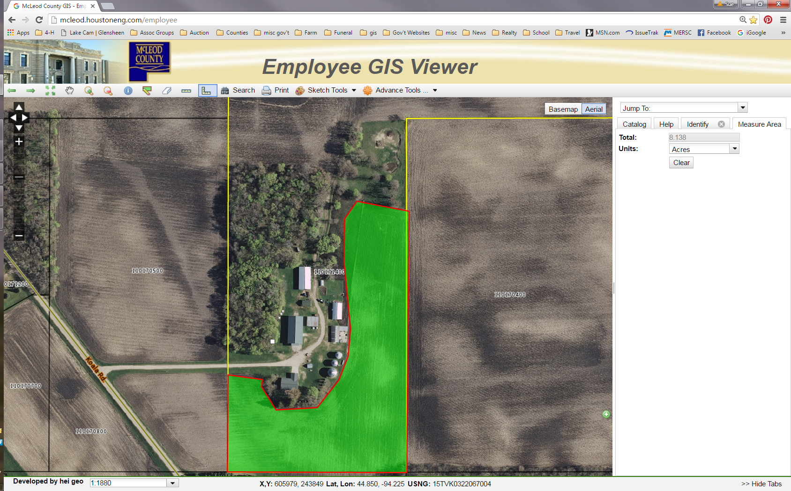

Slide 14
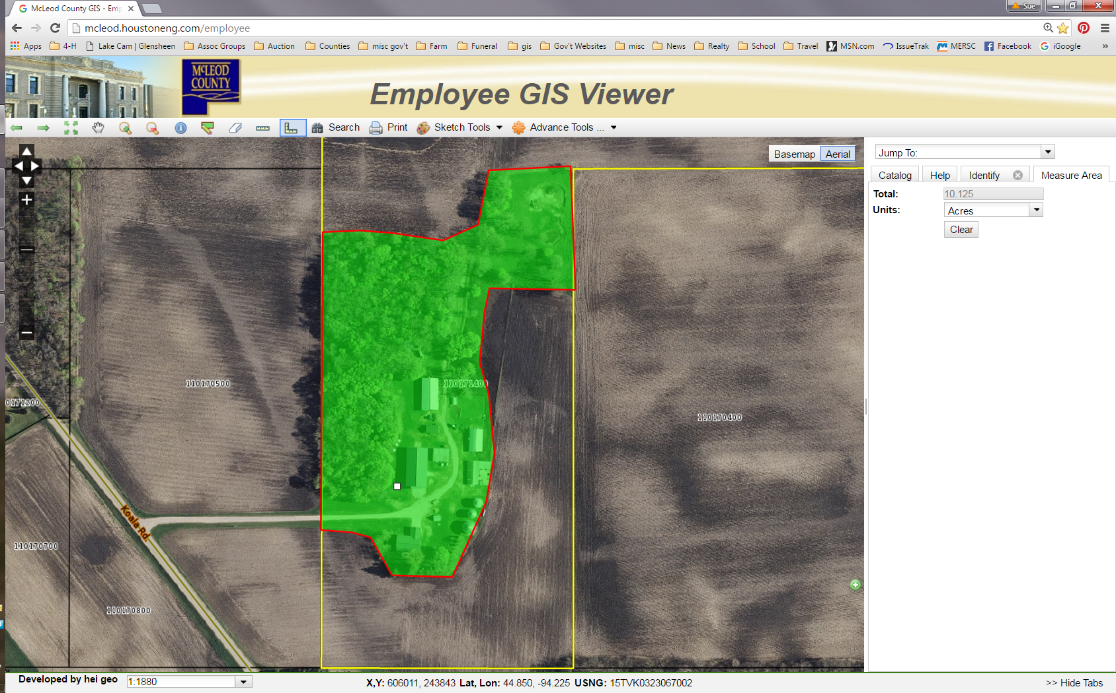

Slide 15
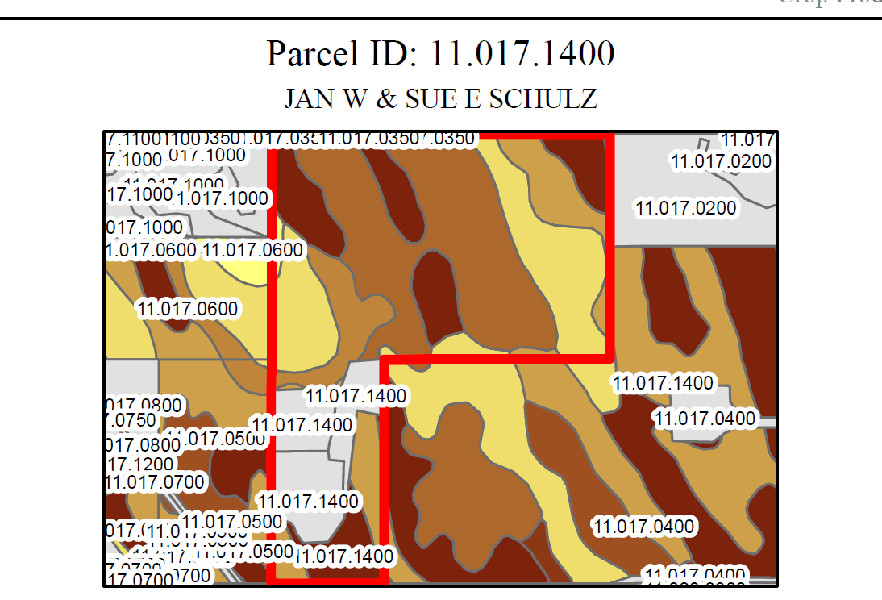

Slide 16
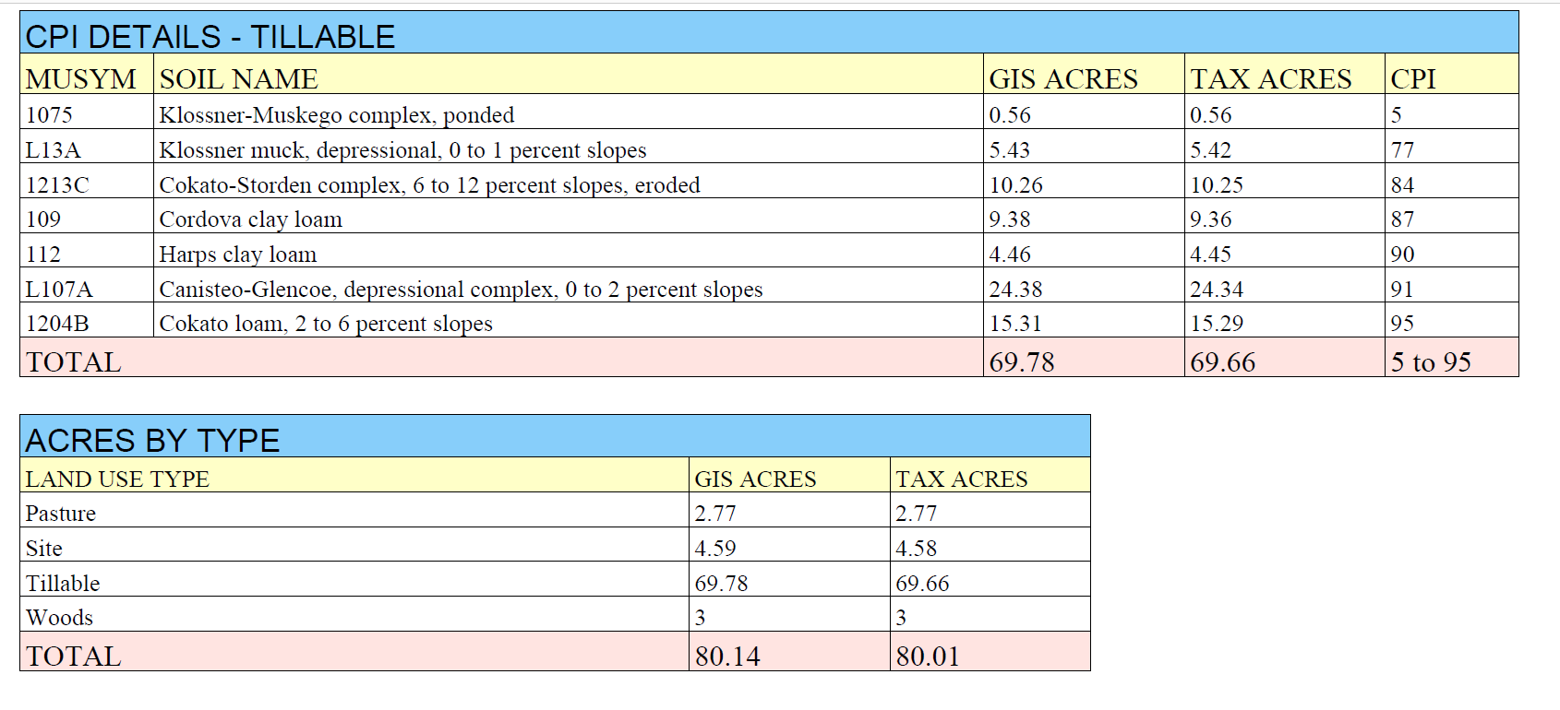

Slide 17
ABC Breakdown
A 108,299.18 Acres
B 58,881.18 Acres
C 58,891.01 Acres
Sub C 3730.82 Acres

Slide 18
CPI Breakdown
91-100 143,142.83 Acres
81-90 63,543.34 Acres
71-80 12,471.52 Acres
61-70 4,429.21 Acres
51-60 708.34 Acres
41-50 1,633.31 Acres
31-40 181.36 Acres
21-30 2.26 Acres
11-20 370.72 Acres
0-10 2,959.31 Acres

Slide 19
 |  | 2015 Farm Land Values
 | A | B | C | Sub C
Acoma | 8900 | 7200 | 5900 | 4600
Bergen | 8900 | 7200 | 5900 | 4600
Collins | 8900 | 7200 | 5900 | 4600
Glencoe | 8900 | 7200 | 5900 | 4600
Hale | 8900 | 7200 | 5900 | 4600
Hassan Valley | 8900 | 7200 | 5900 | 4600
Helen | 8900 | 7200 | 5900 | 4600
Hutchinson | 8900 | 7200 | 5900 | 4600
Lynn | 8900 | 7200 | 5900 | 4600
Penn | 8900 | 7200 | 5900 | 4600
Rich Valley | 8900 | 7200 | 5900 | 4600
Round Grove | 10000 | 8100 | 6800 | 5100
Sumter | 8900 | 7200 | 5900 | 4600
Winsted | 8900 | 7200 | 5900 | 4600

Slide 20
Starting Point
How to determine new values based on the CPI Ratings
I took the average of our 4 categories
26,600/4 = 6650
Next step I took a 5% from that average and created a new cost guide for our Tillable Values

Slide 21
Next Step
I took pure land sales that occurred in the last year
Using the new CPI Report and the new cost guide I determined a new EMV for each sale
I then took a look to see where the sales ratio came in at
Once I felt that new land cost guide was close I then compared to sales going back 2 years
Something to note – when I did this the ag market was in a declining market

Slide 22
 |  |  |  | 2016 Farm Land Values
 | CPI 100-91 | CPI 81-90 | CPI 71-80 | CPI 61-70 | CPI 51-60 | CPI 41-50 | CPI 31-40 | CPI 21-30 | CPI 11-20 | CPI 0-10
Acoma | 7000 | 6700 | 6000 | 5500 | 5000 | 4400 | 4000 | 3500 | 3100 | 2800
Bergen | 7000 | 6700 | 6000 | 5500 | 5000 | 4400 | 4000 | 3500 | 3100 | 2800
Collins | 7000 | 6700 | 6000 | 5500 | 5000 | 4400 | 4000 | 3500 | 3100 | 2800
Glencoe | 7000 | 6700 | 6000 | 5500 | 5000 | 4400 | 4000 | 3500 | 3100 | 2800
Hale | 7000 | 6700 | 6000 | 5500 | 5000 | 4400 | 4000 | 3500 | 3100 | 2800
Hassan Valley | 7000 | 6700 | 6000 | 5500 | 5000 | 4400 | 4000 | 3500 | 3100 | 2800
Helen | 7000 | 6700 | 6000 | 5500 | 5000 | 4400 | 4000 | 3500 | 3100 | 2800
Hutchinson | 7000 | 6700 | 6000 | 5500 | 5000 | 4400 | 4000 | 3500 | 3100 | 2800
Lynn | 7000 | 6700 | 6000 | 5500 | 5000 | 4400 | 4000 | 3500 | 3100 | 2800
Penn | 7000 | 6700 | 6000 | 5500 | 5000 | 4400 | 4000 | 3500 | 3100 | 2800
Rich Valley | 7000 | 6700 | 6000 | 5500 | 5000 | 4400 | 4000 | 3500 | 3100 | 2800
Round Grove | 7000 | 6700 | 6000 | 5500 | 5000 | 4400 | 4000 | 3500 | 3100 | 2800
Sumter | 7000 | 6700 | 6000 | 5500 | 5000 | 4400 | 4000 | 3500 | 3100 | 2800
Winsted | 7000 | 6700 | 6000 | 5500 | 5000 | 4400 | 4000 | 3500 | 3100 | 2800

Slide 23
Sales Ratio
We are required to be between 90-105% of Market
Our sales study runs from October to September of each year
Our Agricultural ratio to the 2016 assessment is 104%
Our Agricultural ratio as of March for the 2017 assessment (with the CPI valuations) is 100%

Slide 24
Value Changes
 | Agricultural
 | 2015 | 2015 | 2015 |  | 2016 | 2016 | 2016 |  | Overall | Tillable
 | Land | Building | Tillable |  | Land | Building | Tillable |  | Change | Change
Acoma | 107,787,800 | 12,621,500 | 96,600,900 |  | 98,371,300 | 13,003,800 | 86,963,800 |  | -8 % | -10 %
Bergen | 131,936,900 | 18,701,000 | 118,190,400 |  | 115,605,900 | 18,415,100 | 101,830,400 |  | -11 % | -14 %
Collins | 137,619,200 | 8,289,300 | 132,286,100 |  | 122,463,300 | 8,635,500 | 116,671,900 |  | -10 % | -12 %
Glencoe | 136,032,700 | 10,449,600 | 129,642,500 |  | 121,619,900 | 10,342,800 | 115,009,300 |  | -10 % | -11 %
Hale | 129,902,600 | 14,779,800 | 117,465,900 |  | 118,702,500 | 14,212,800 | 106,585,800 |  | -8 % | -9 %
Hassan Valley | 128,828,800 | 10,141,100 | 122,518,400 |  | 116,441,200 | 11,967,100 | 109,878,400 |  | - 8 % | --10 %
Helen | 145,630,900 | 17,904,600 | 135,721,600 |  | 130,310,000 | 17,766,400 | 120,530,900 |  | -9 % | -11 %
Hutchinson | 118,843,700 | 14,824,500 | 107,259,200 |  | 106,904,000 | 16,053,000 | 94,906,800 |  | -8 % | -12 %
Lynn | 123,774,300 | 10,228,700 | 116,178,500 |  | 107,821,500 | 10,987,400 | 100,304,200 |  | -12 % | -14 %
Penn | 144,443,900 | 8,023,800 | 137,851,800 |  | 128,834,300 | 7,455,800 | 122,386,700 |  | -11 % | -11 %
Rich Valley | 135,305,600 | 15,615,700 | 122,612,200 |  | 121,104,200 | 16,158,300 | 108,575,100 |  | -9 % | -11 %
Round Grove | 176,079,000 | 3,752,700 | 171,600,200 |  | 141,280,800 | 3,906,300 | 136,994,400 |  | -19 % | -20 %
Sumter | 140,427,000 | 8,966,100 | 134,834,400 |  | 120,626,800 | 8,563,500 | 115,786,100 |  | -14 % | -14 %
Winsted | 130,493,900 | 21,880,700 | 117,926,400 |  | 115,285,300 | 22,076,900 | 102,528,500 |  | -10 % | -13 %

Slide 25
Resources
www.co.mcleod.mn.us
Assessors
Fact Sheets
Soil Survey Part 1
Soil Survey Part 2
www.websoilsurvey.sc.egov.usda.gov
www.acrevalue.com
www.nrcs.usda.gov

